Slide 1
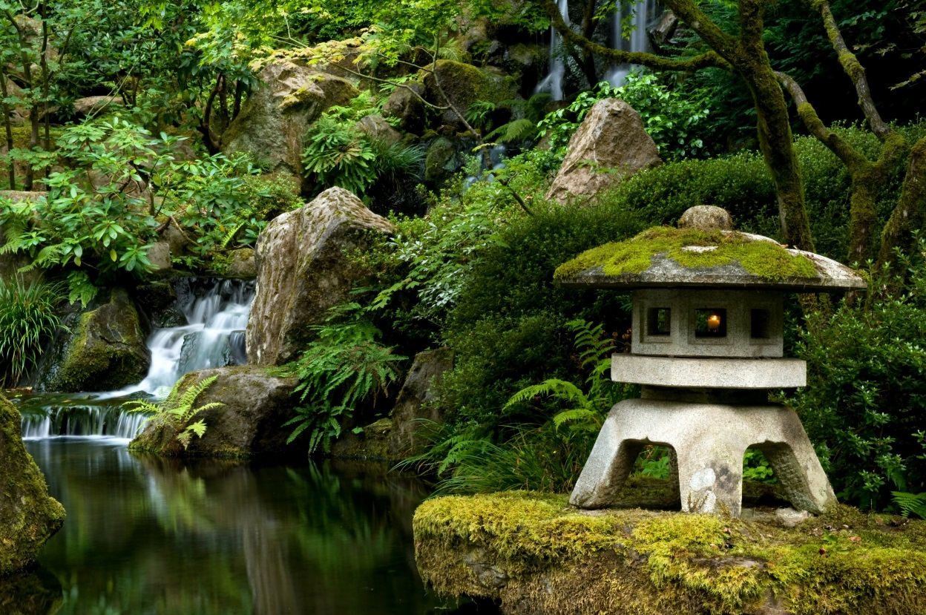
Portland Japanese Garden
Welcomes YOU to
HAIKU ALIVE!

Slide 2
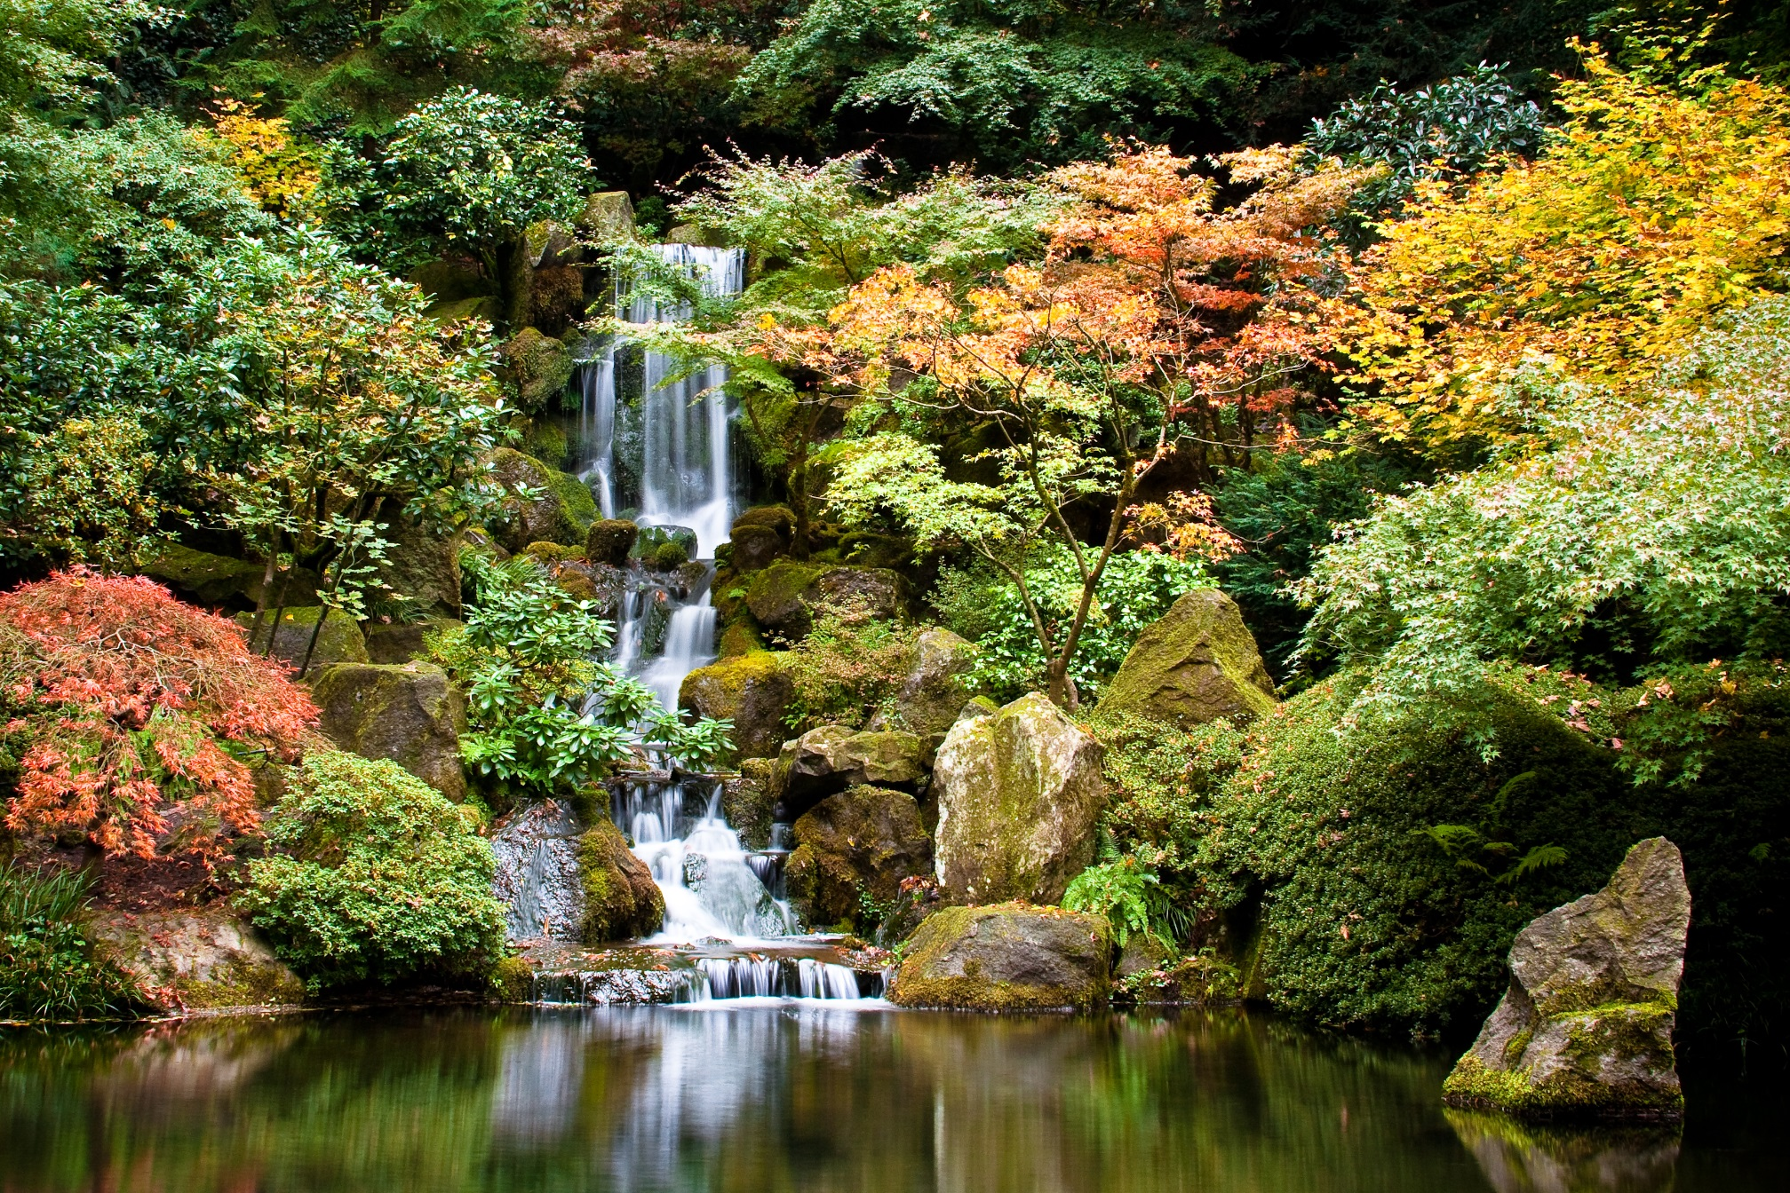
Portland Japanese Garden brings lessons of living in harmony with nature right into the city – and to you!

Slide 3
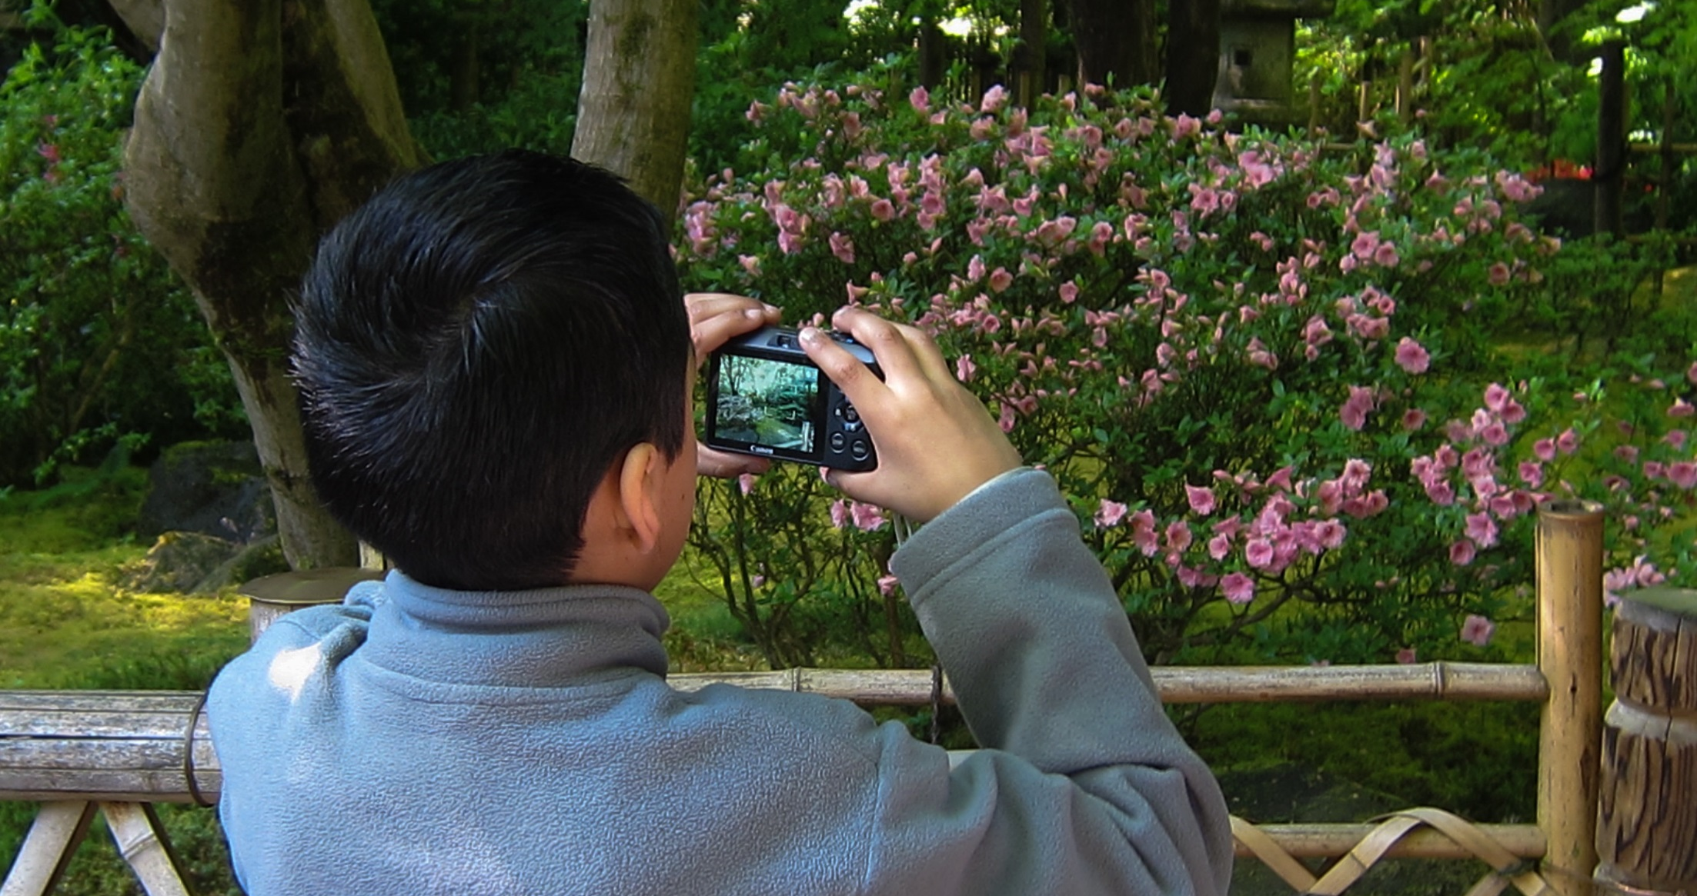
The Japanese garden is a natural teacher and all students are natural learners!

Slide 4
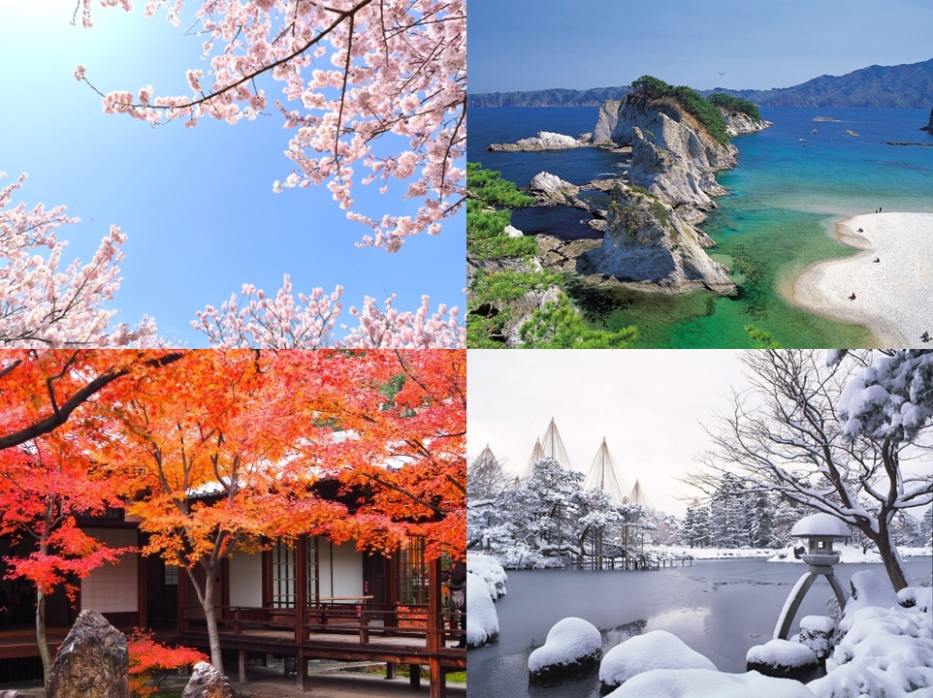
Awaken your five senses to nature’s four seasons!

Slide 5
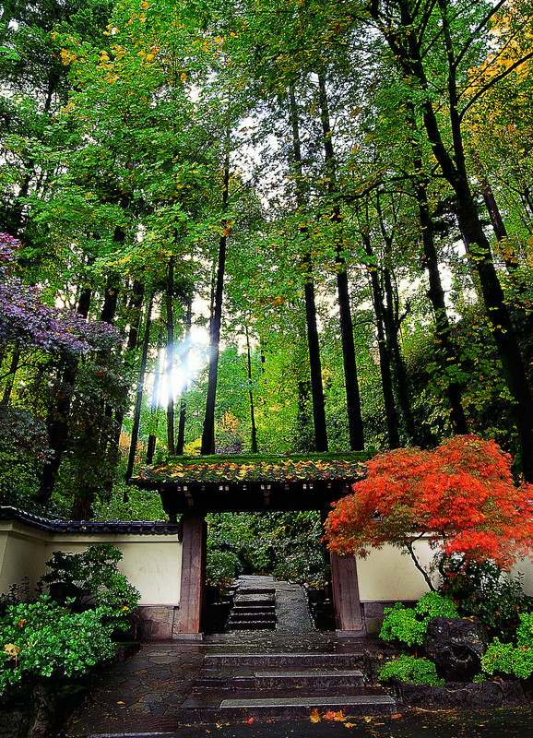
Step inside Portland
Japanese Garden…

Slide 6
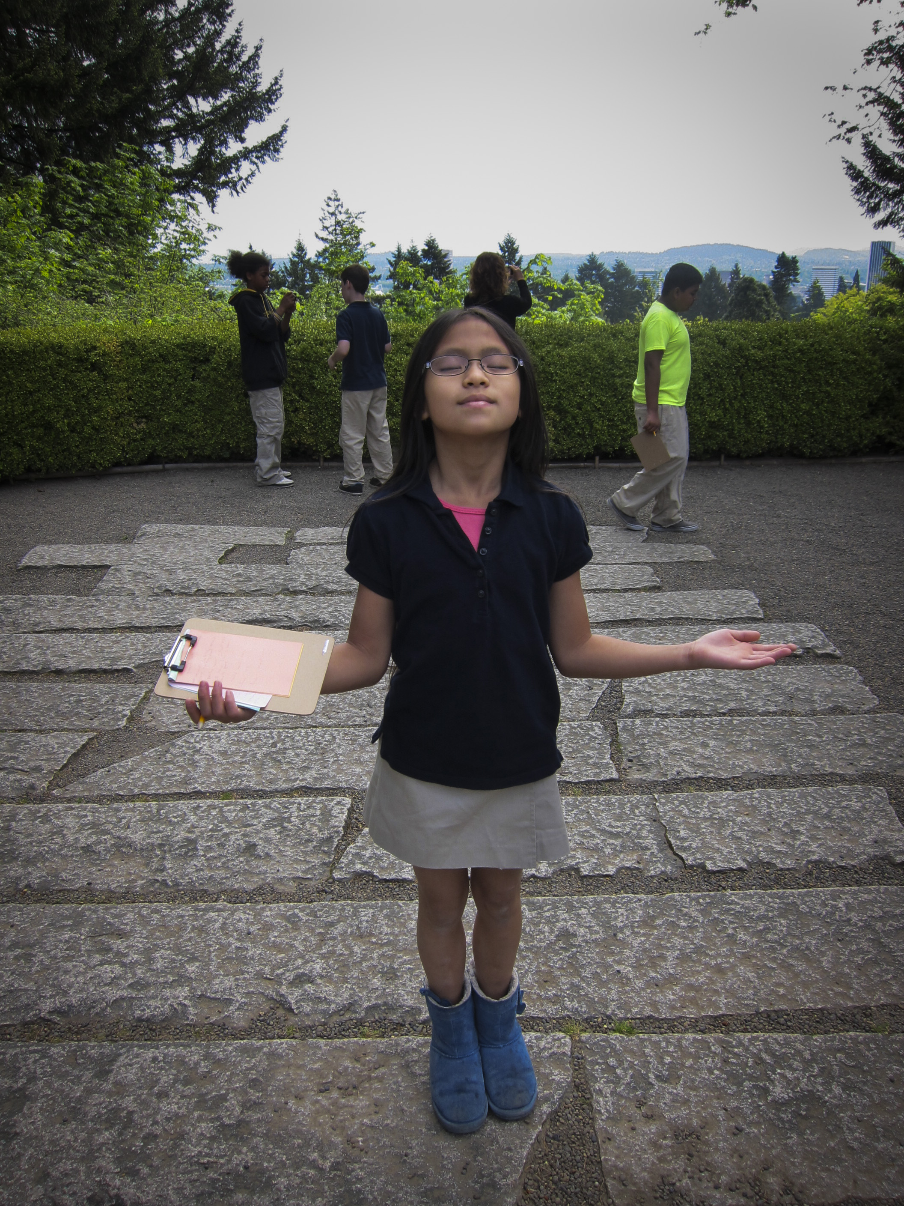
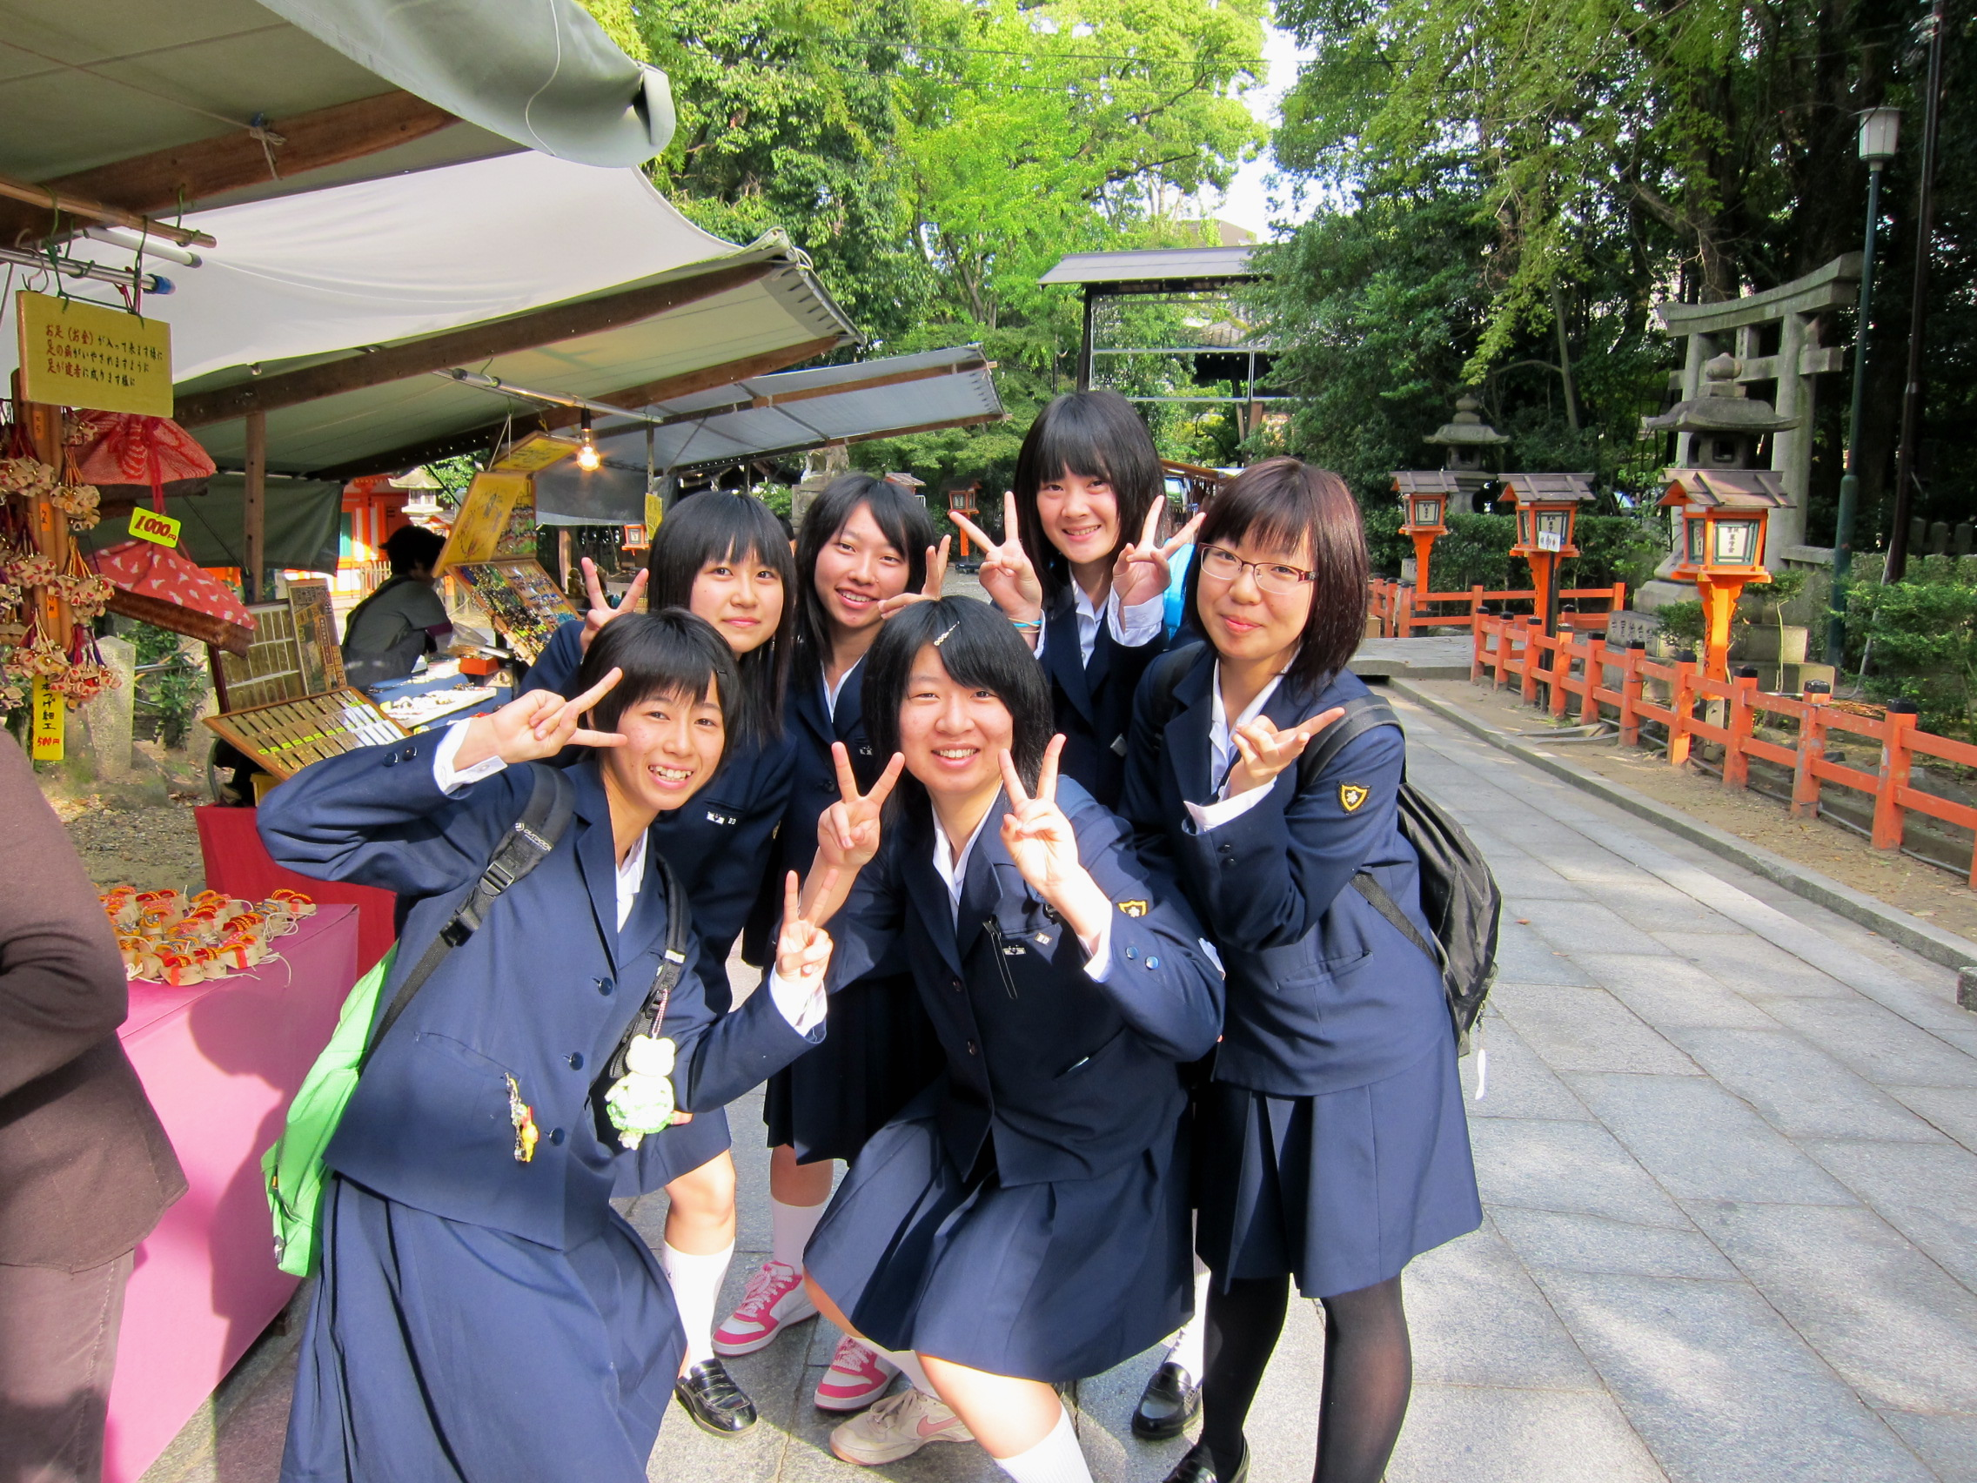
Portland Japanese Garden began 50 years ago as a bridge of friendship between the U.S. and Japan
Finding peace
Portland, Oregon USA
Sharing Friendship
Kyoto, Japan

Slide 7
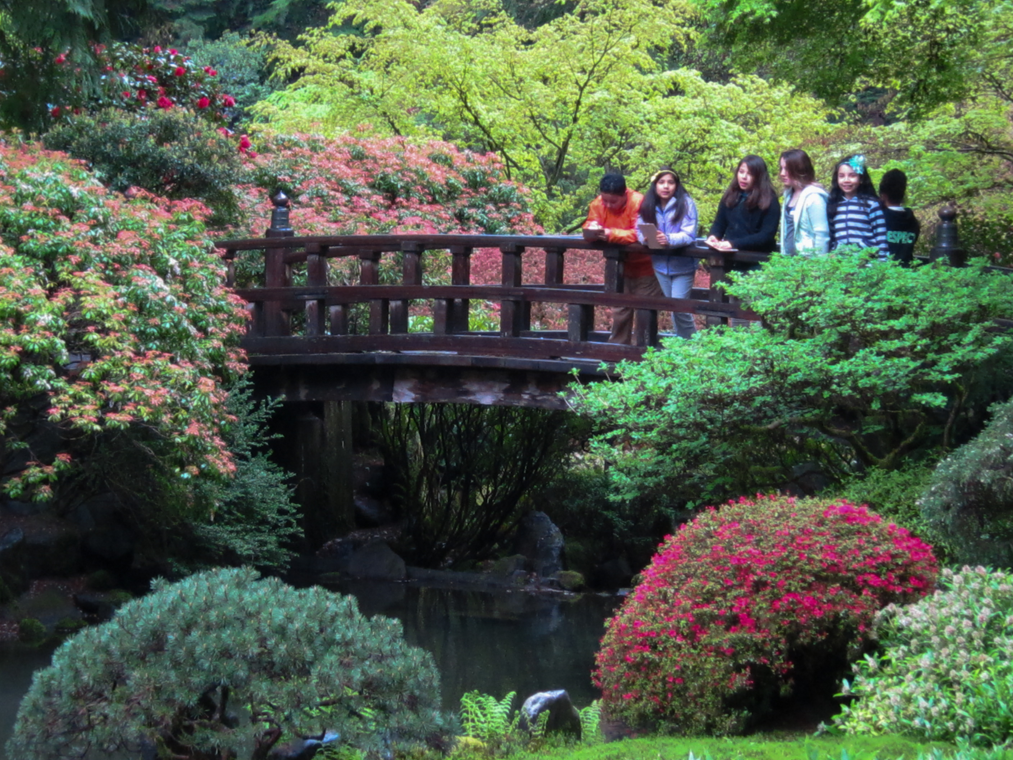
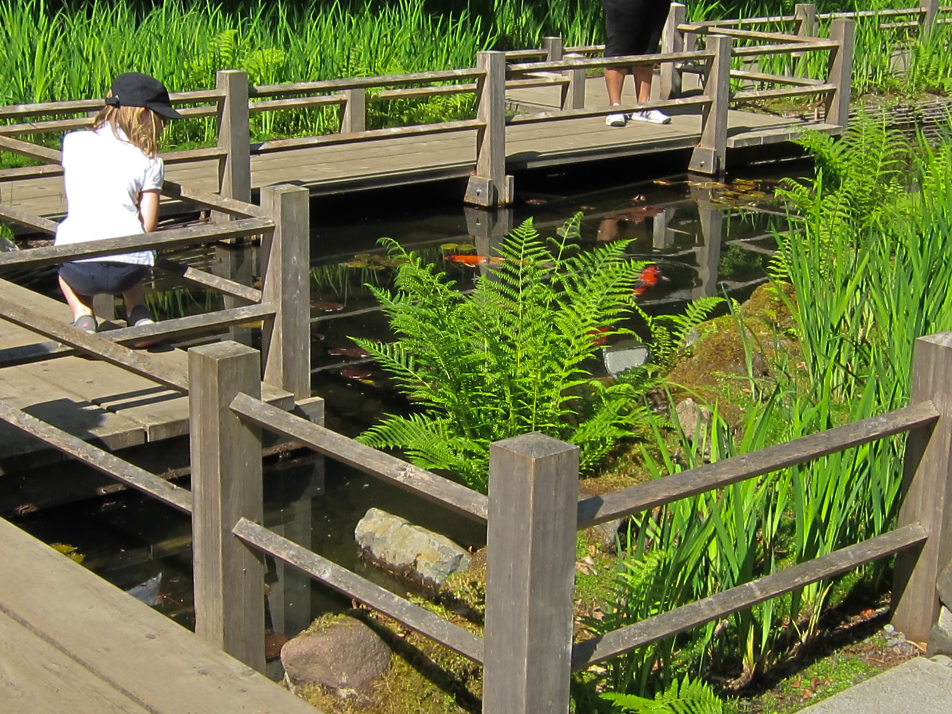
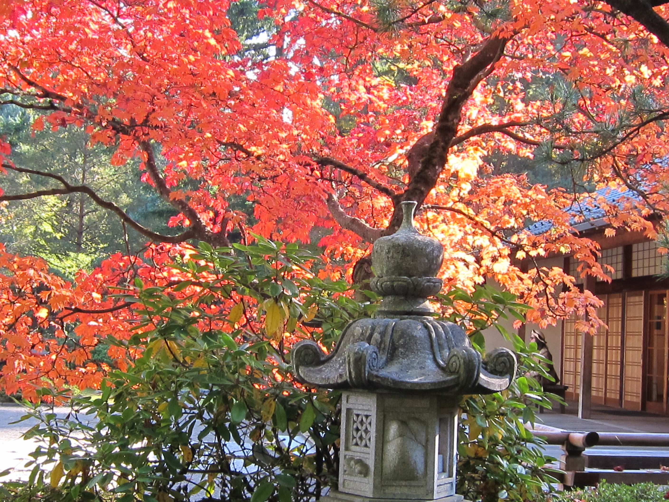
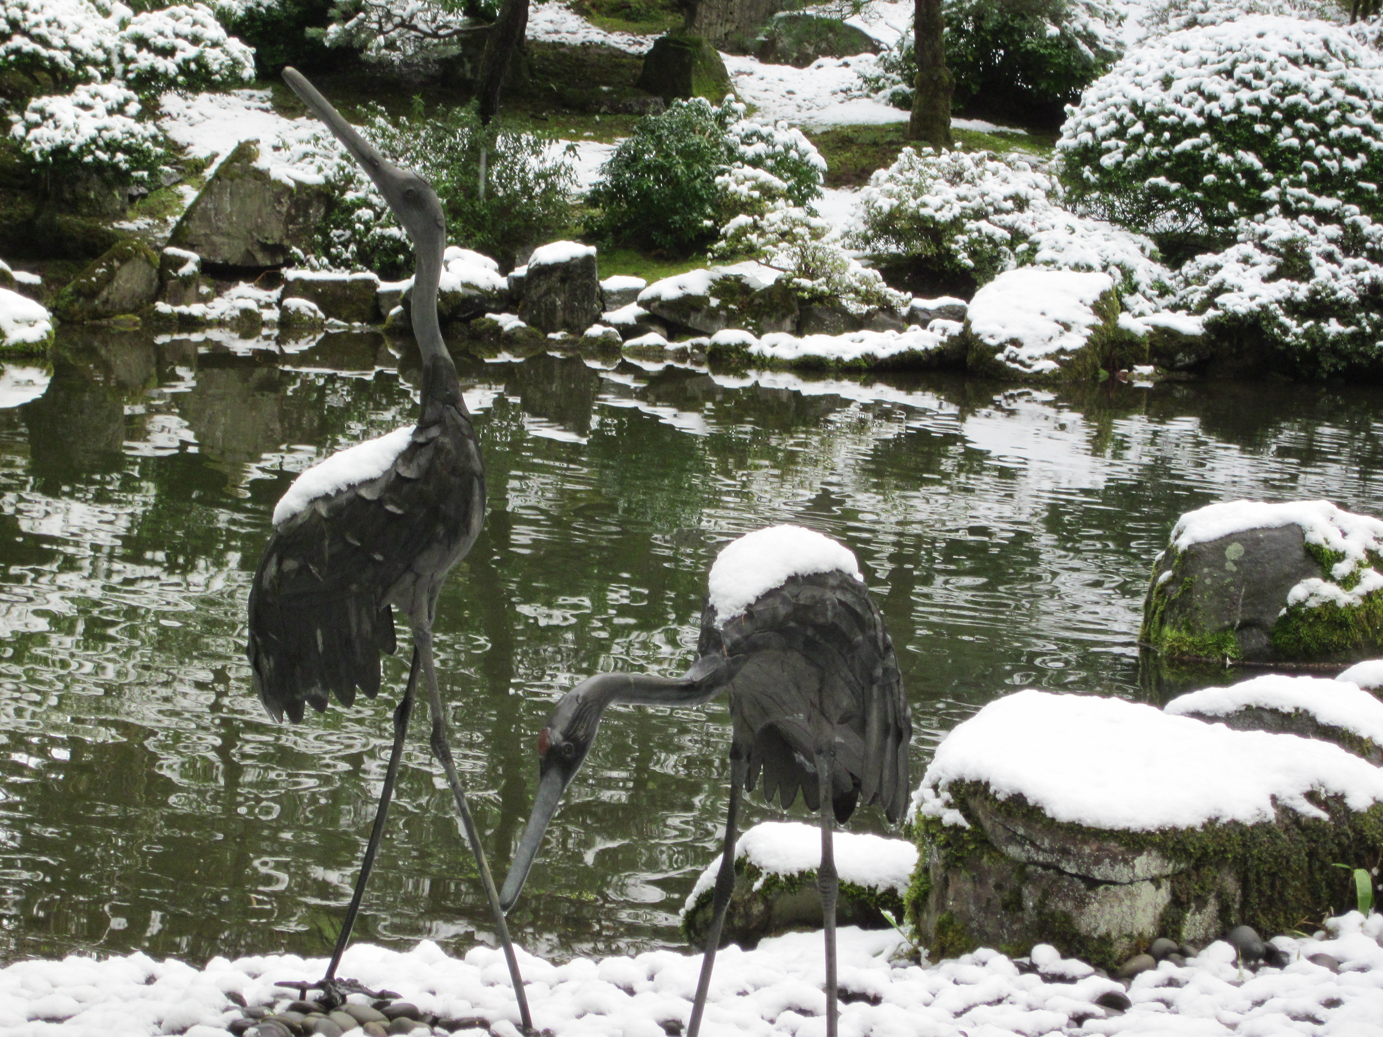
Around the world, people adopt Japanese customs of living in nature’s rhythms

Slide 8
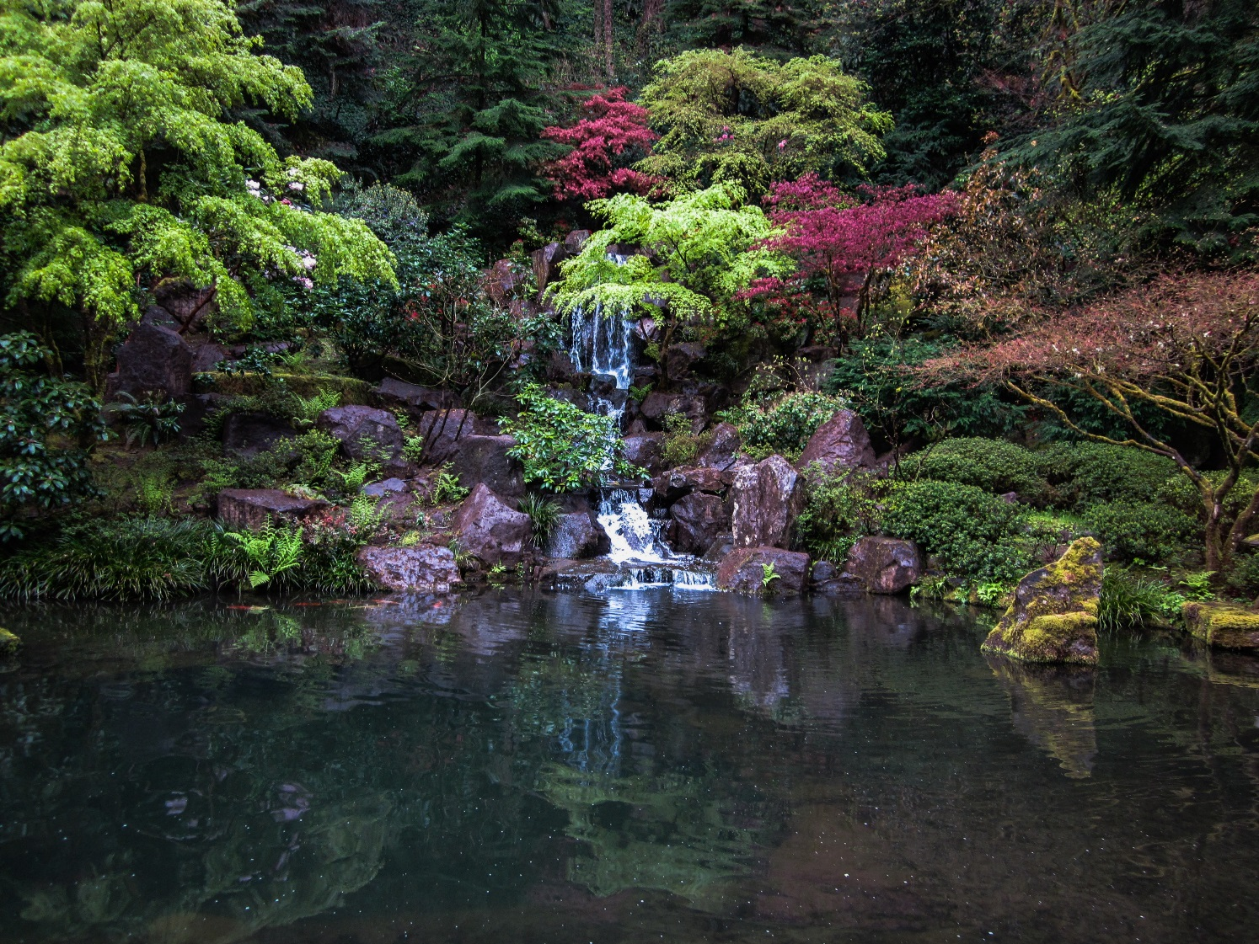
Step into Portland Japanese Garden to awaken your five senses

Slide 9
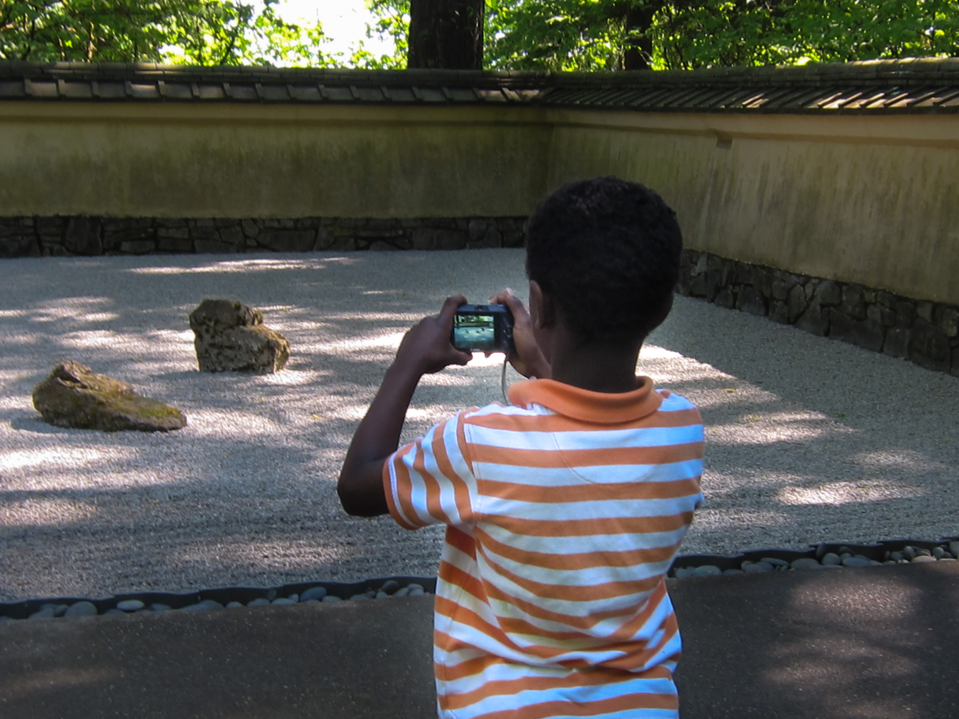
HEAR
Hush and stillness of sand and stone

Slide 10
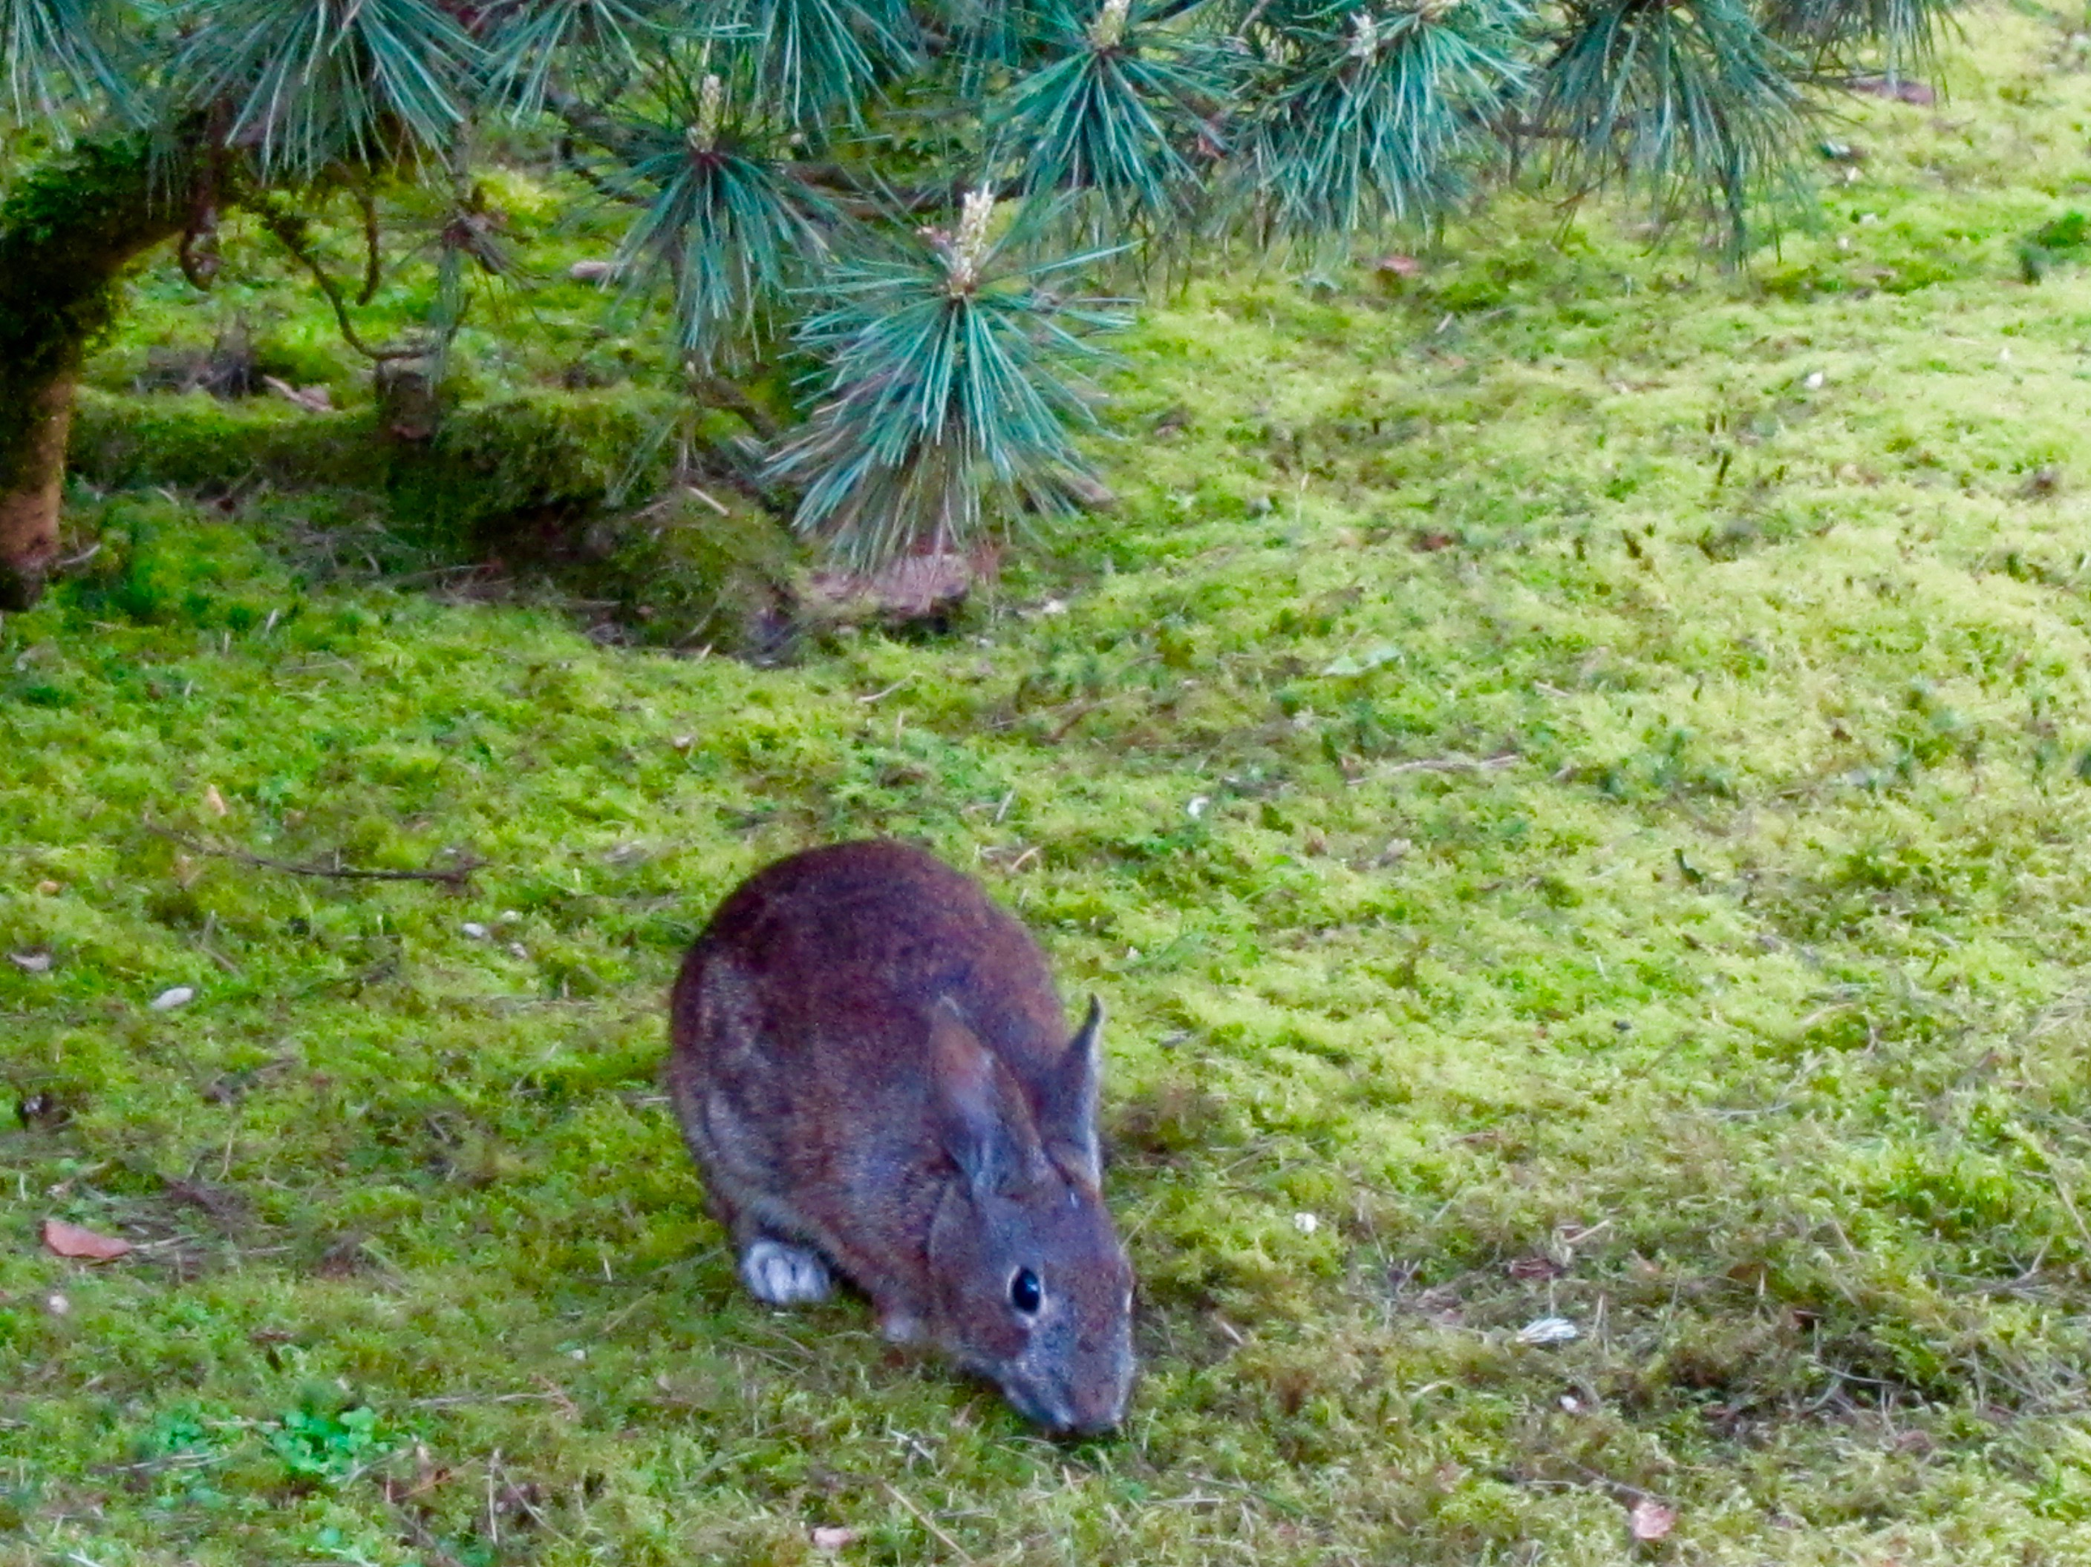
TASTE fresh green of the moss, trees, and pines

Slide 11
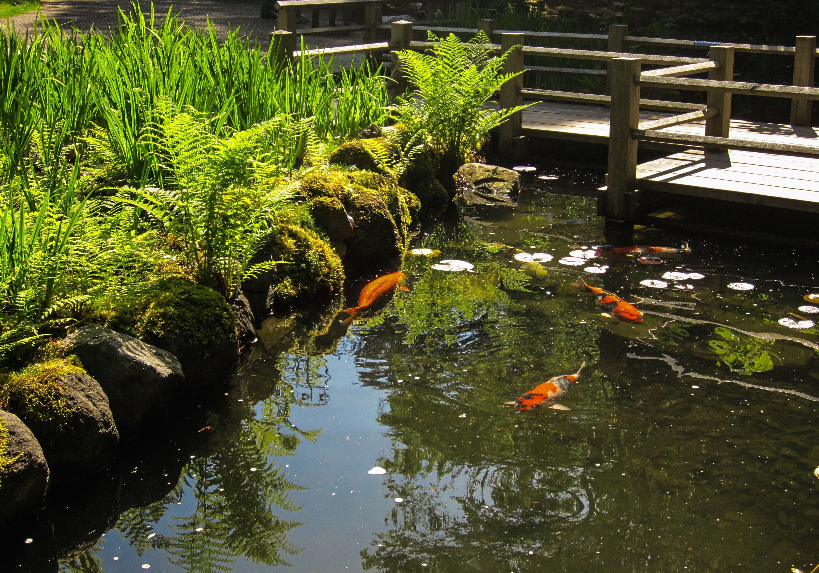
FEEL happy on the Zig-Zag Bridge with koi

Slide 12
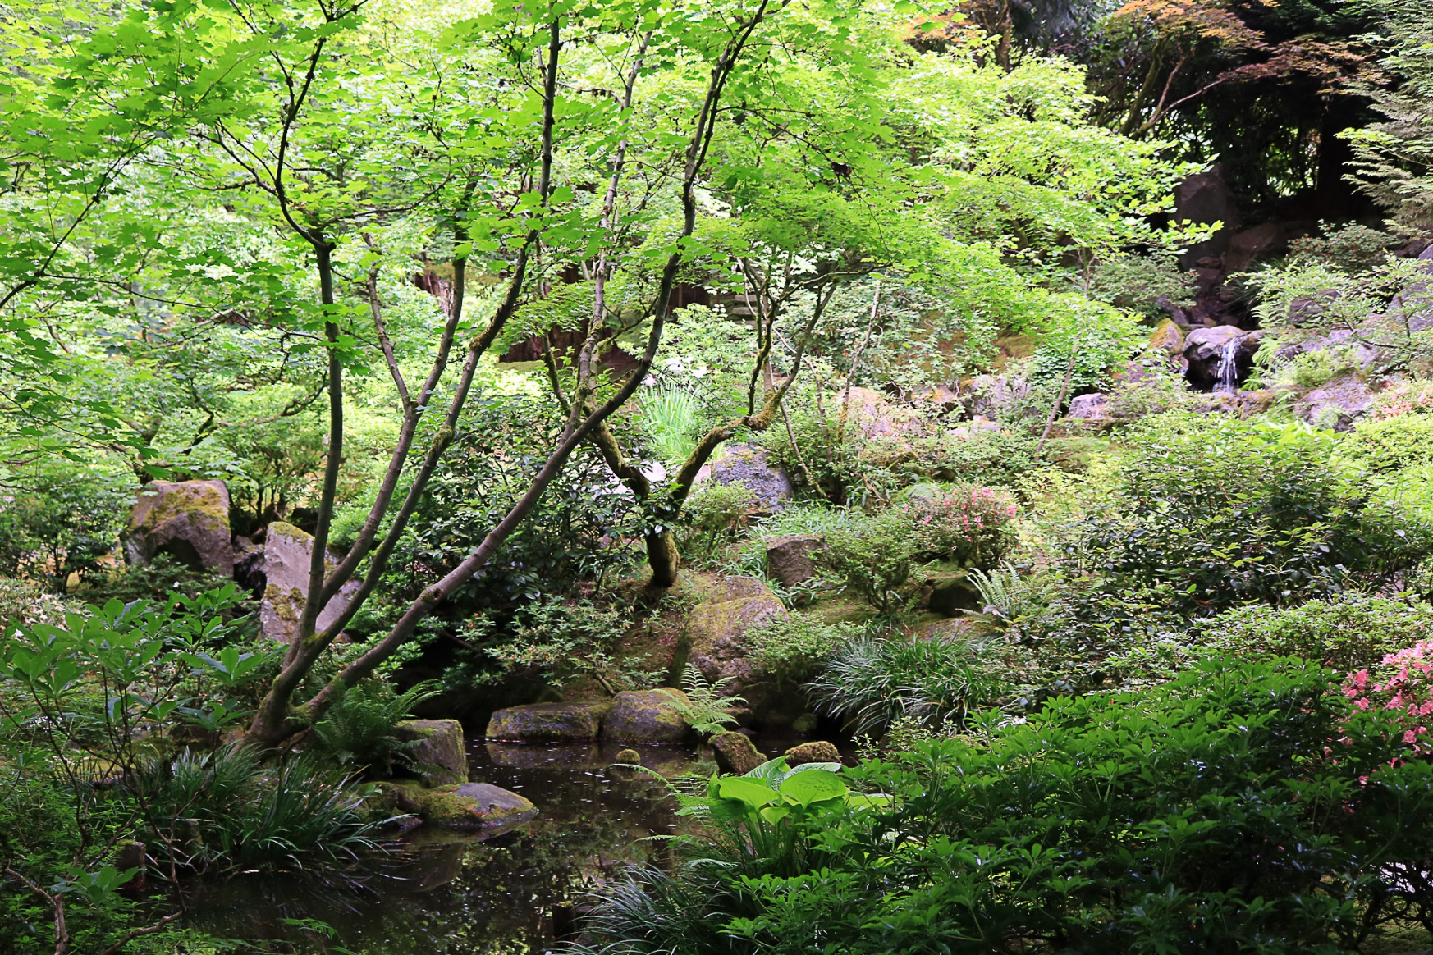
SMELL mixed-up crazy scents of water, stone, plants

Slide 13
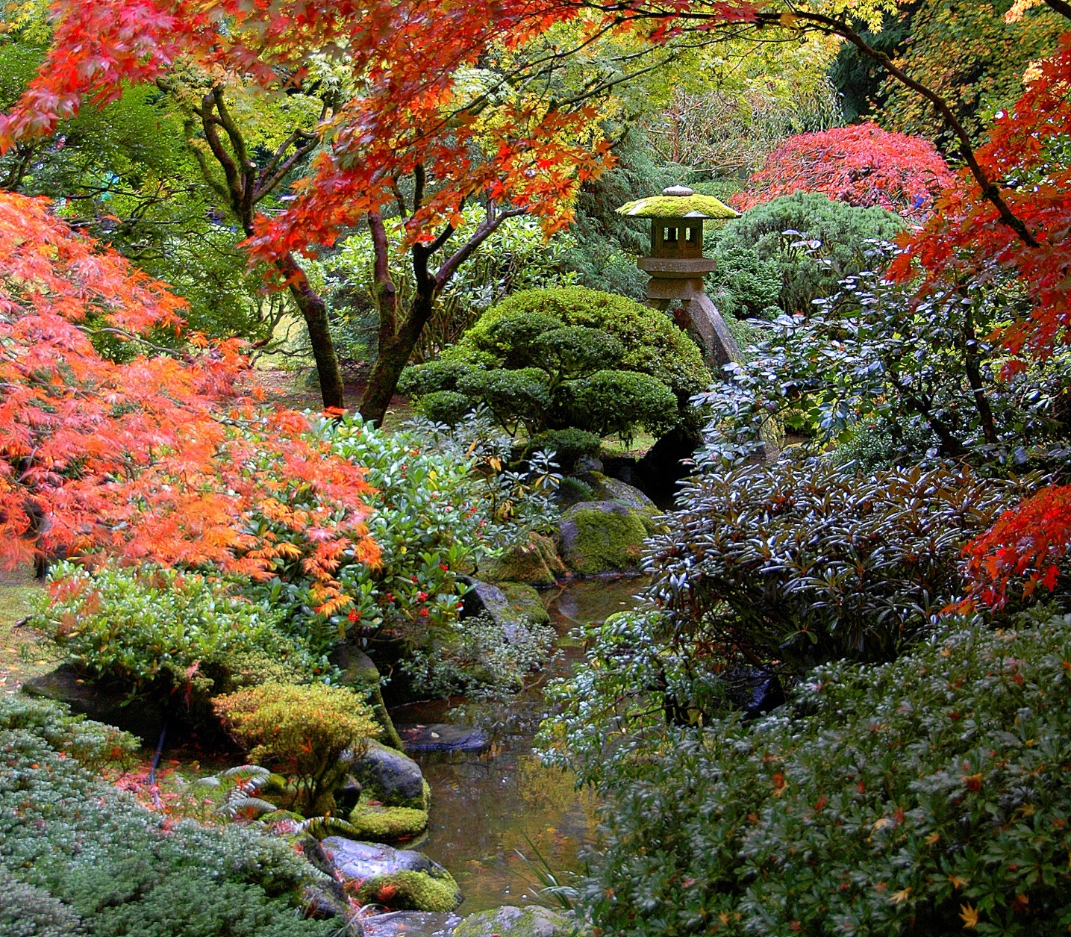
SEE beauty and harmony ALIVE everywhere!

Slide 14
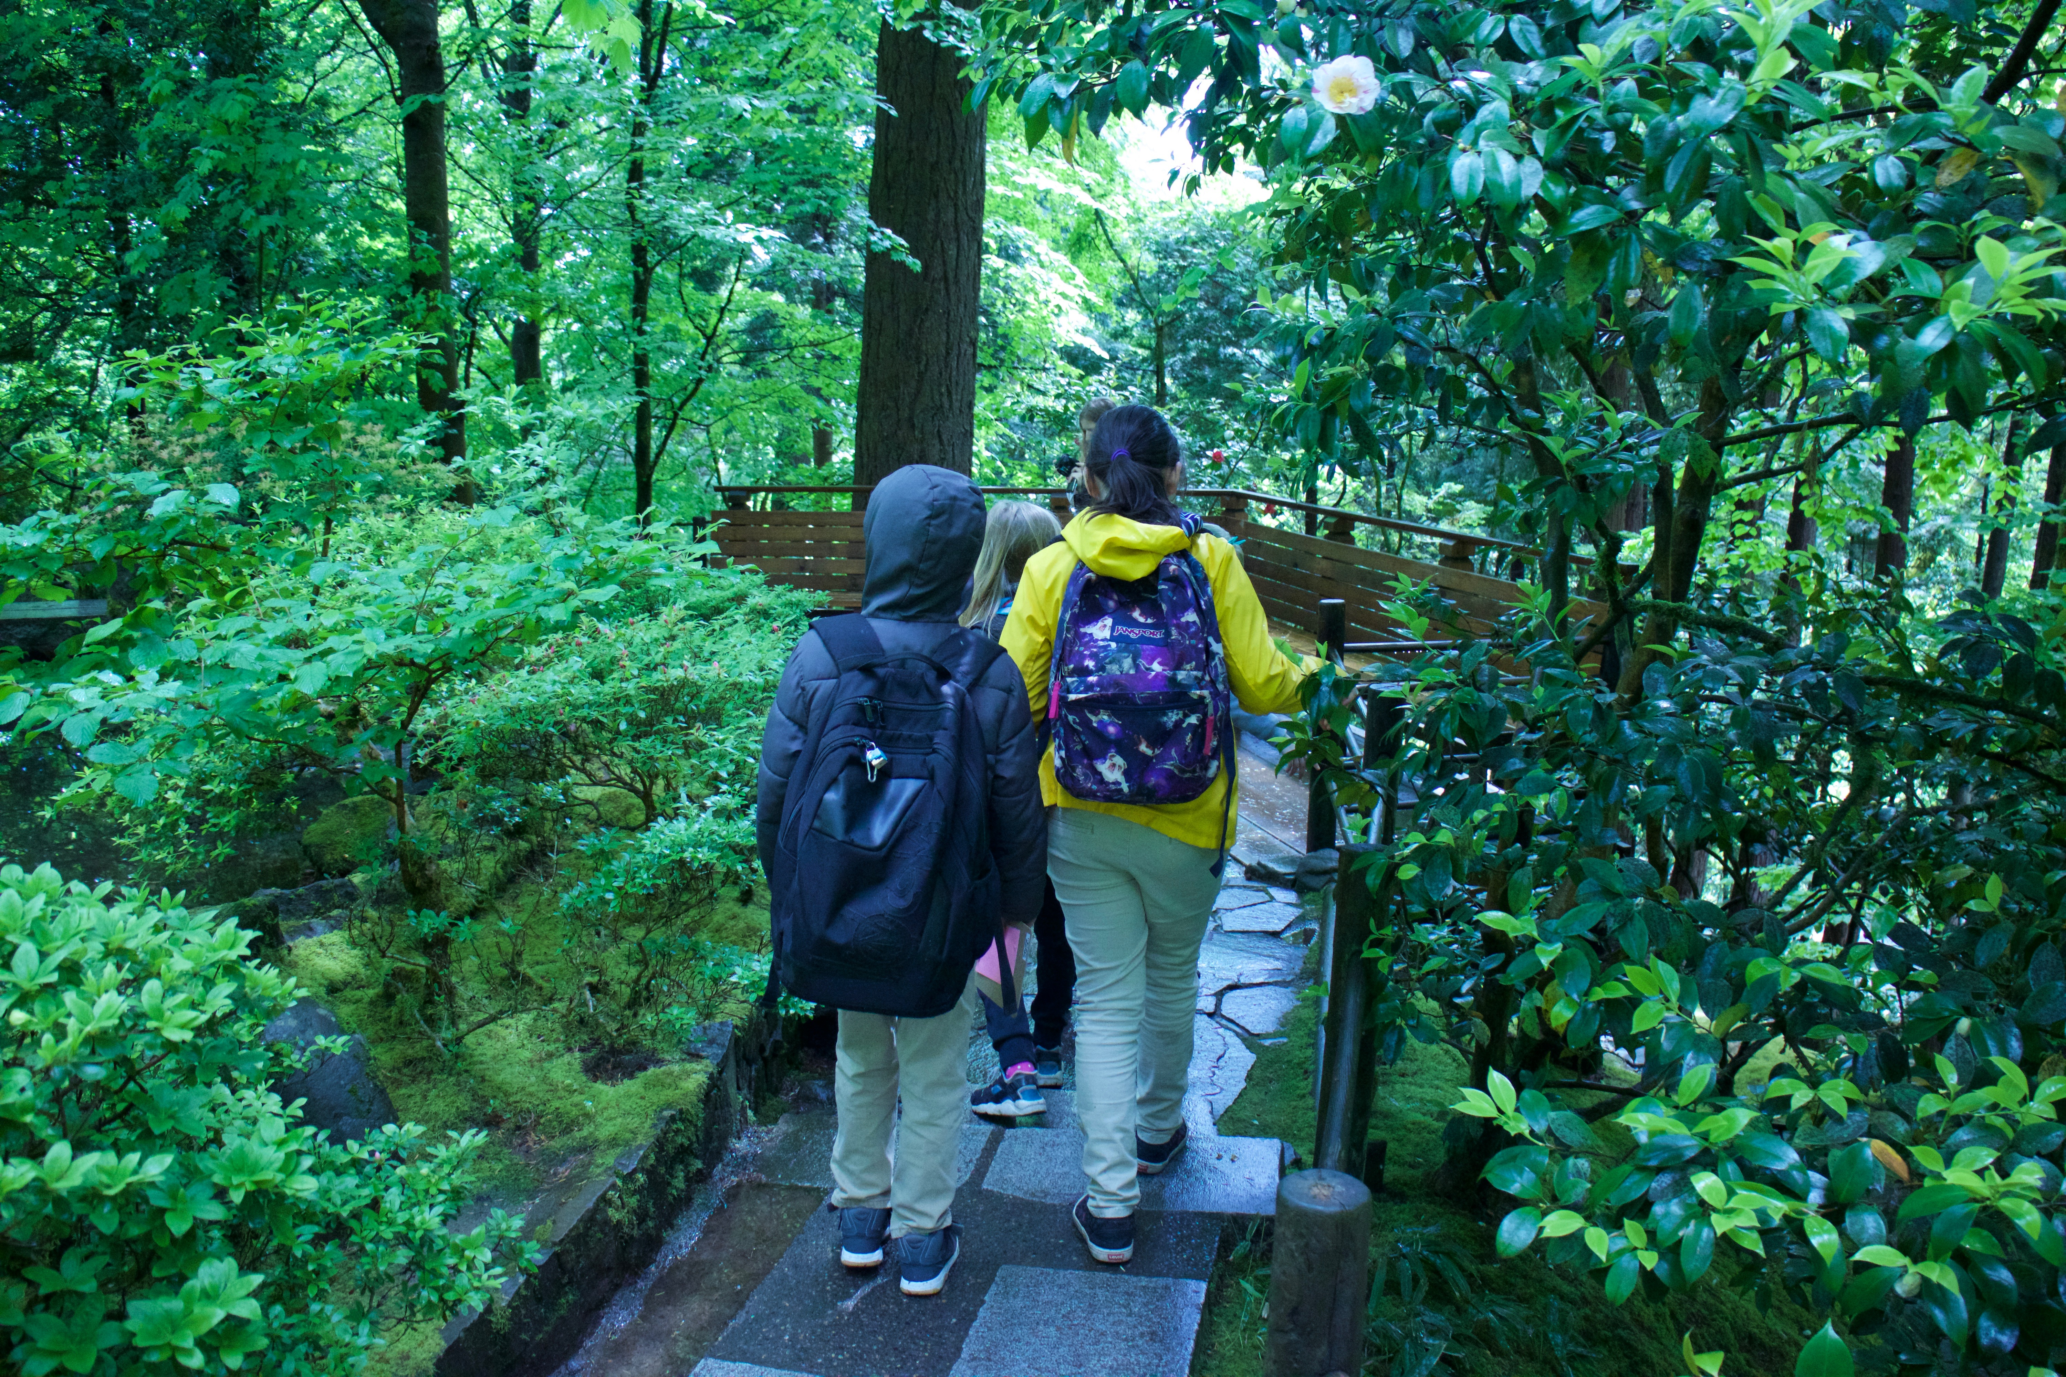
The Japanese believe nature brings health. In Japan, people practice SHINRIN-YOKU: forest bathing
https://youtu.be/stuZaKB9j7I

Slide 15
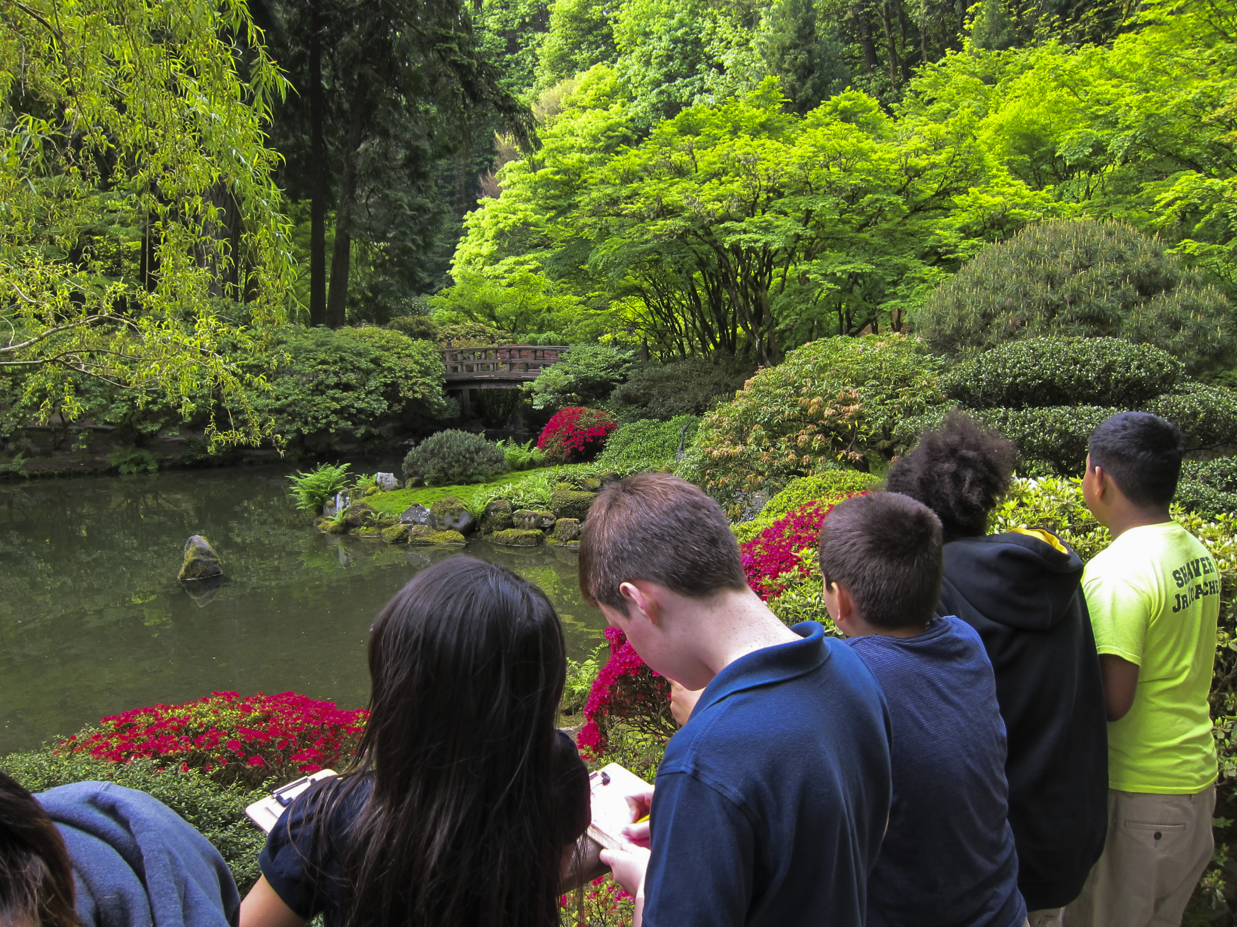
In Portland Japanese Garden, students practice awakening their five senses in nature

Slide 16
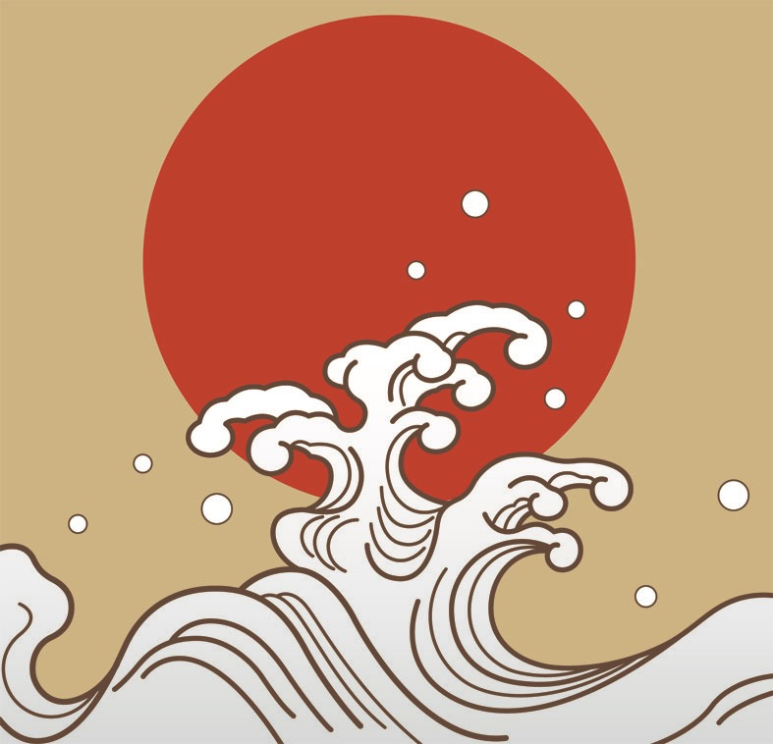
Learning about Japan…

Slide 17
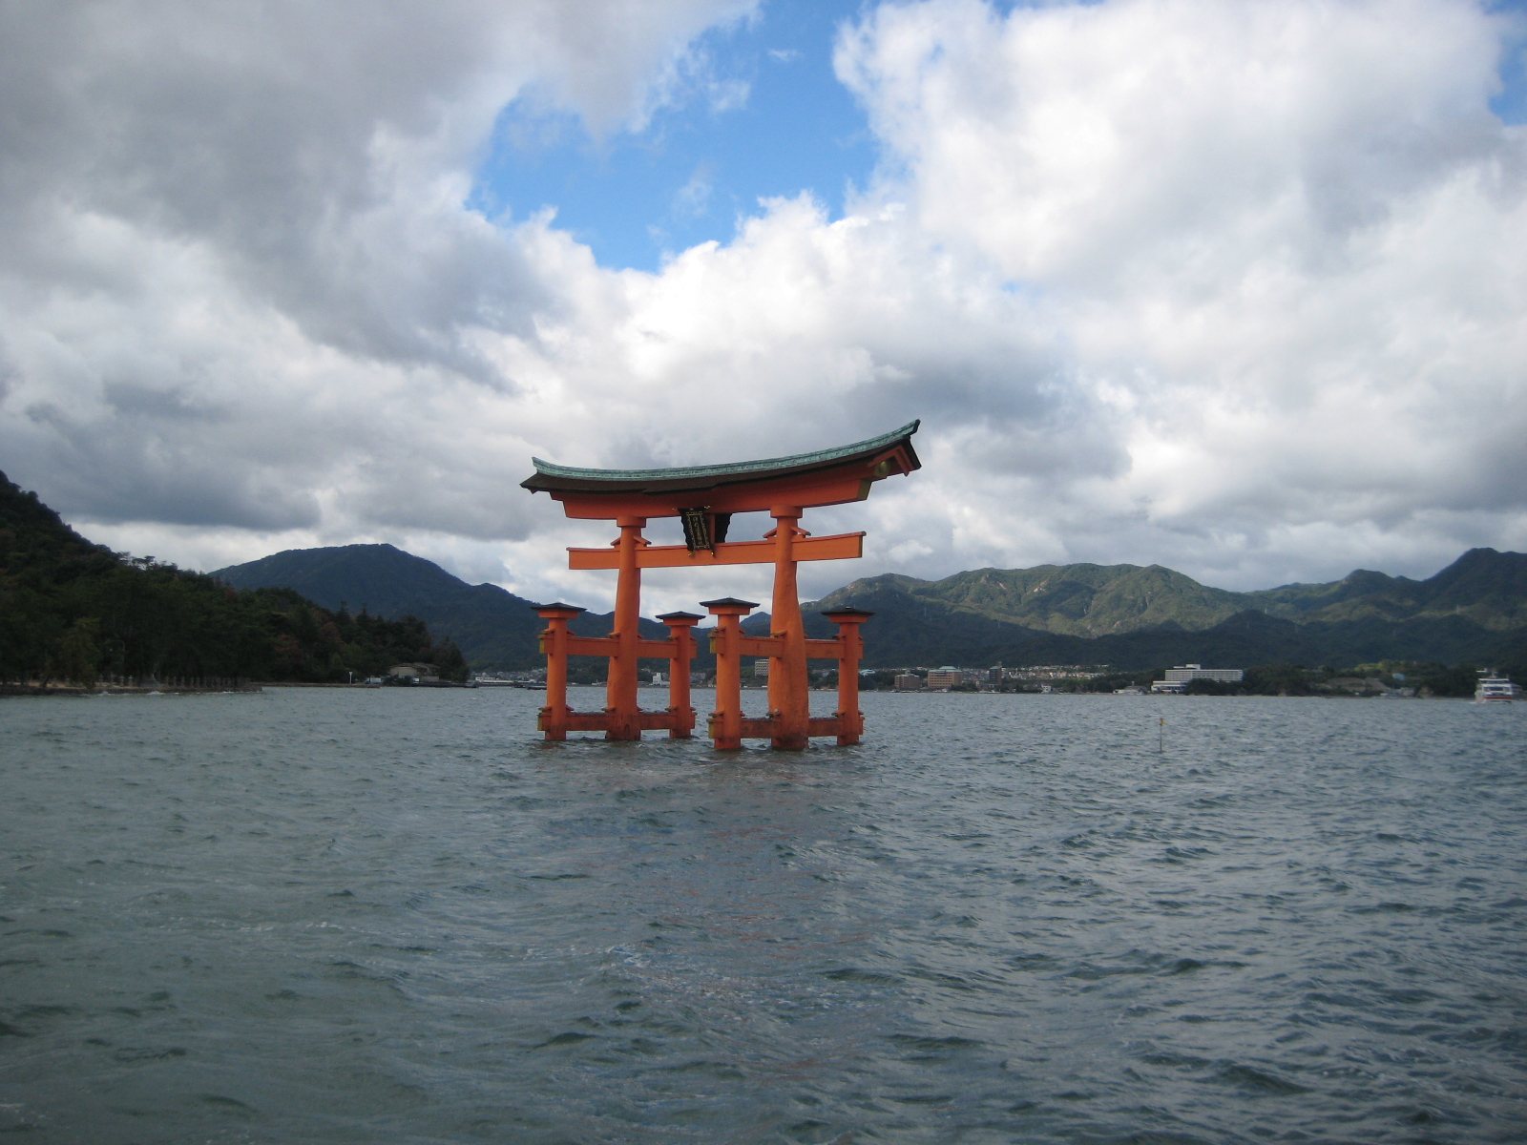
Japan is a country in Asia made up of many islands. In Japan people live close to nature.

Slide 18
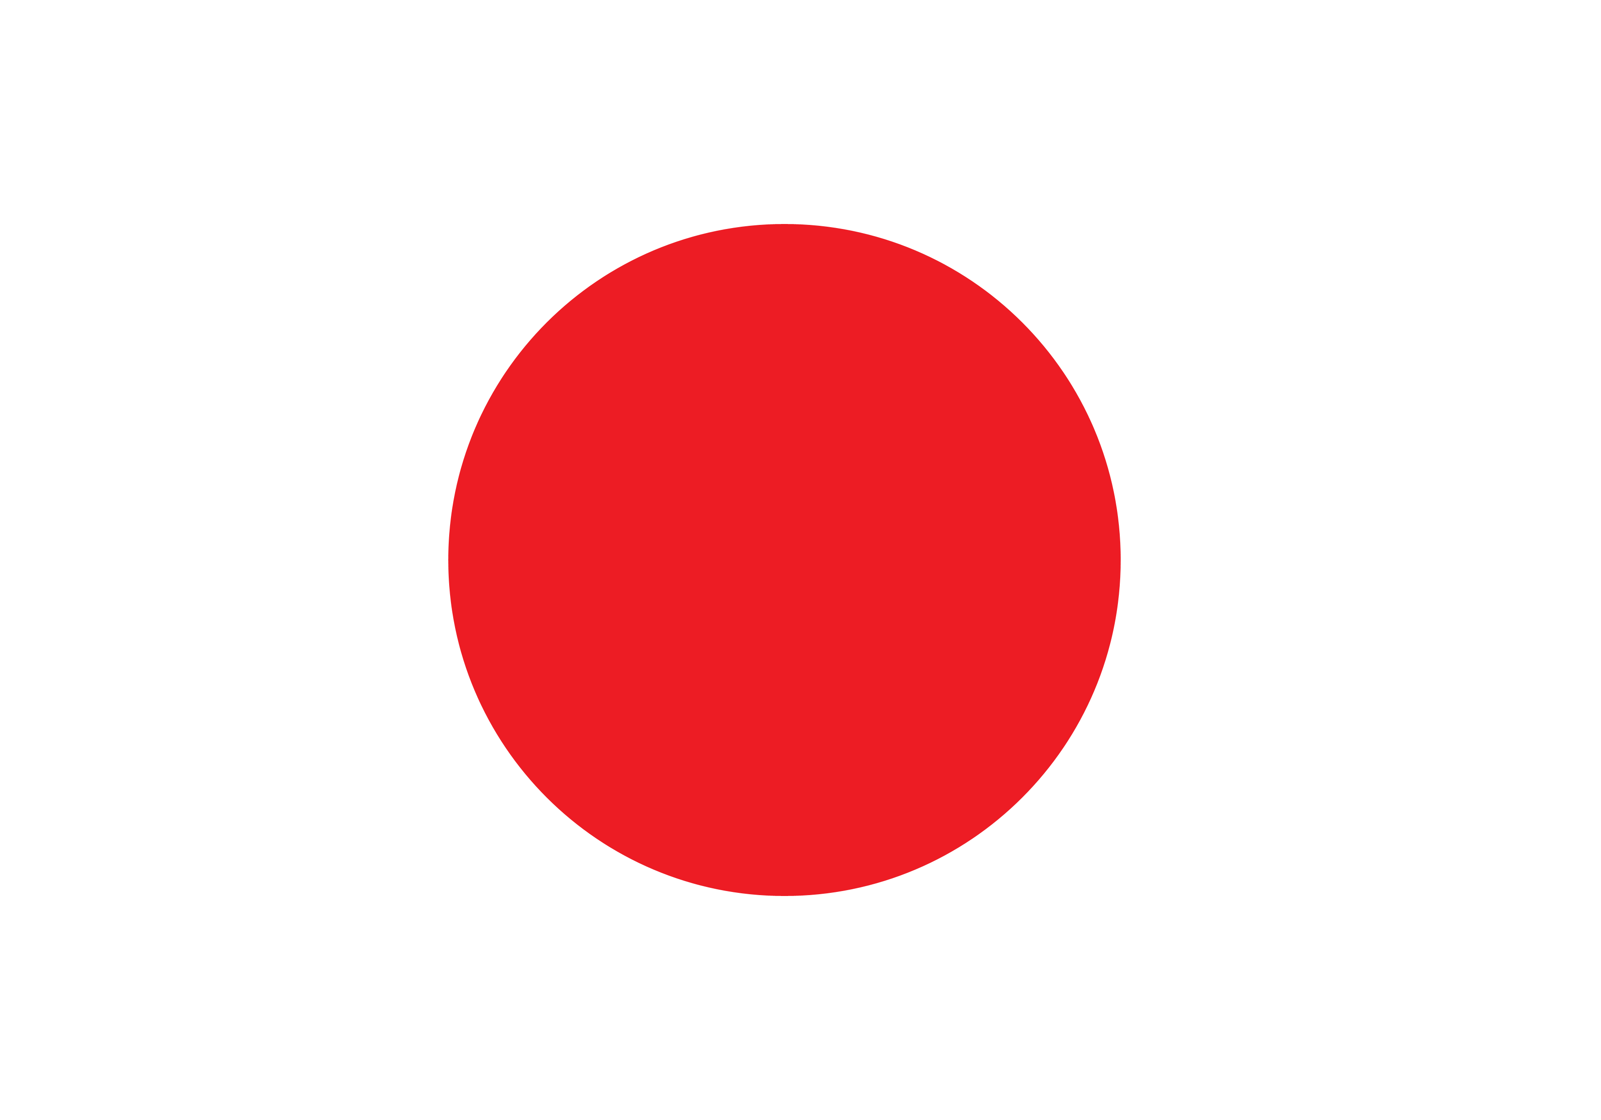
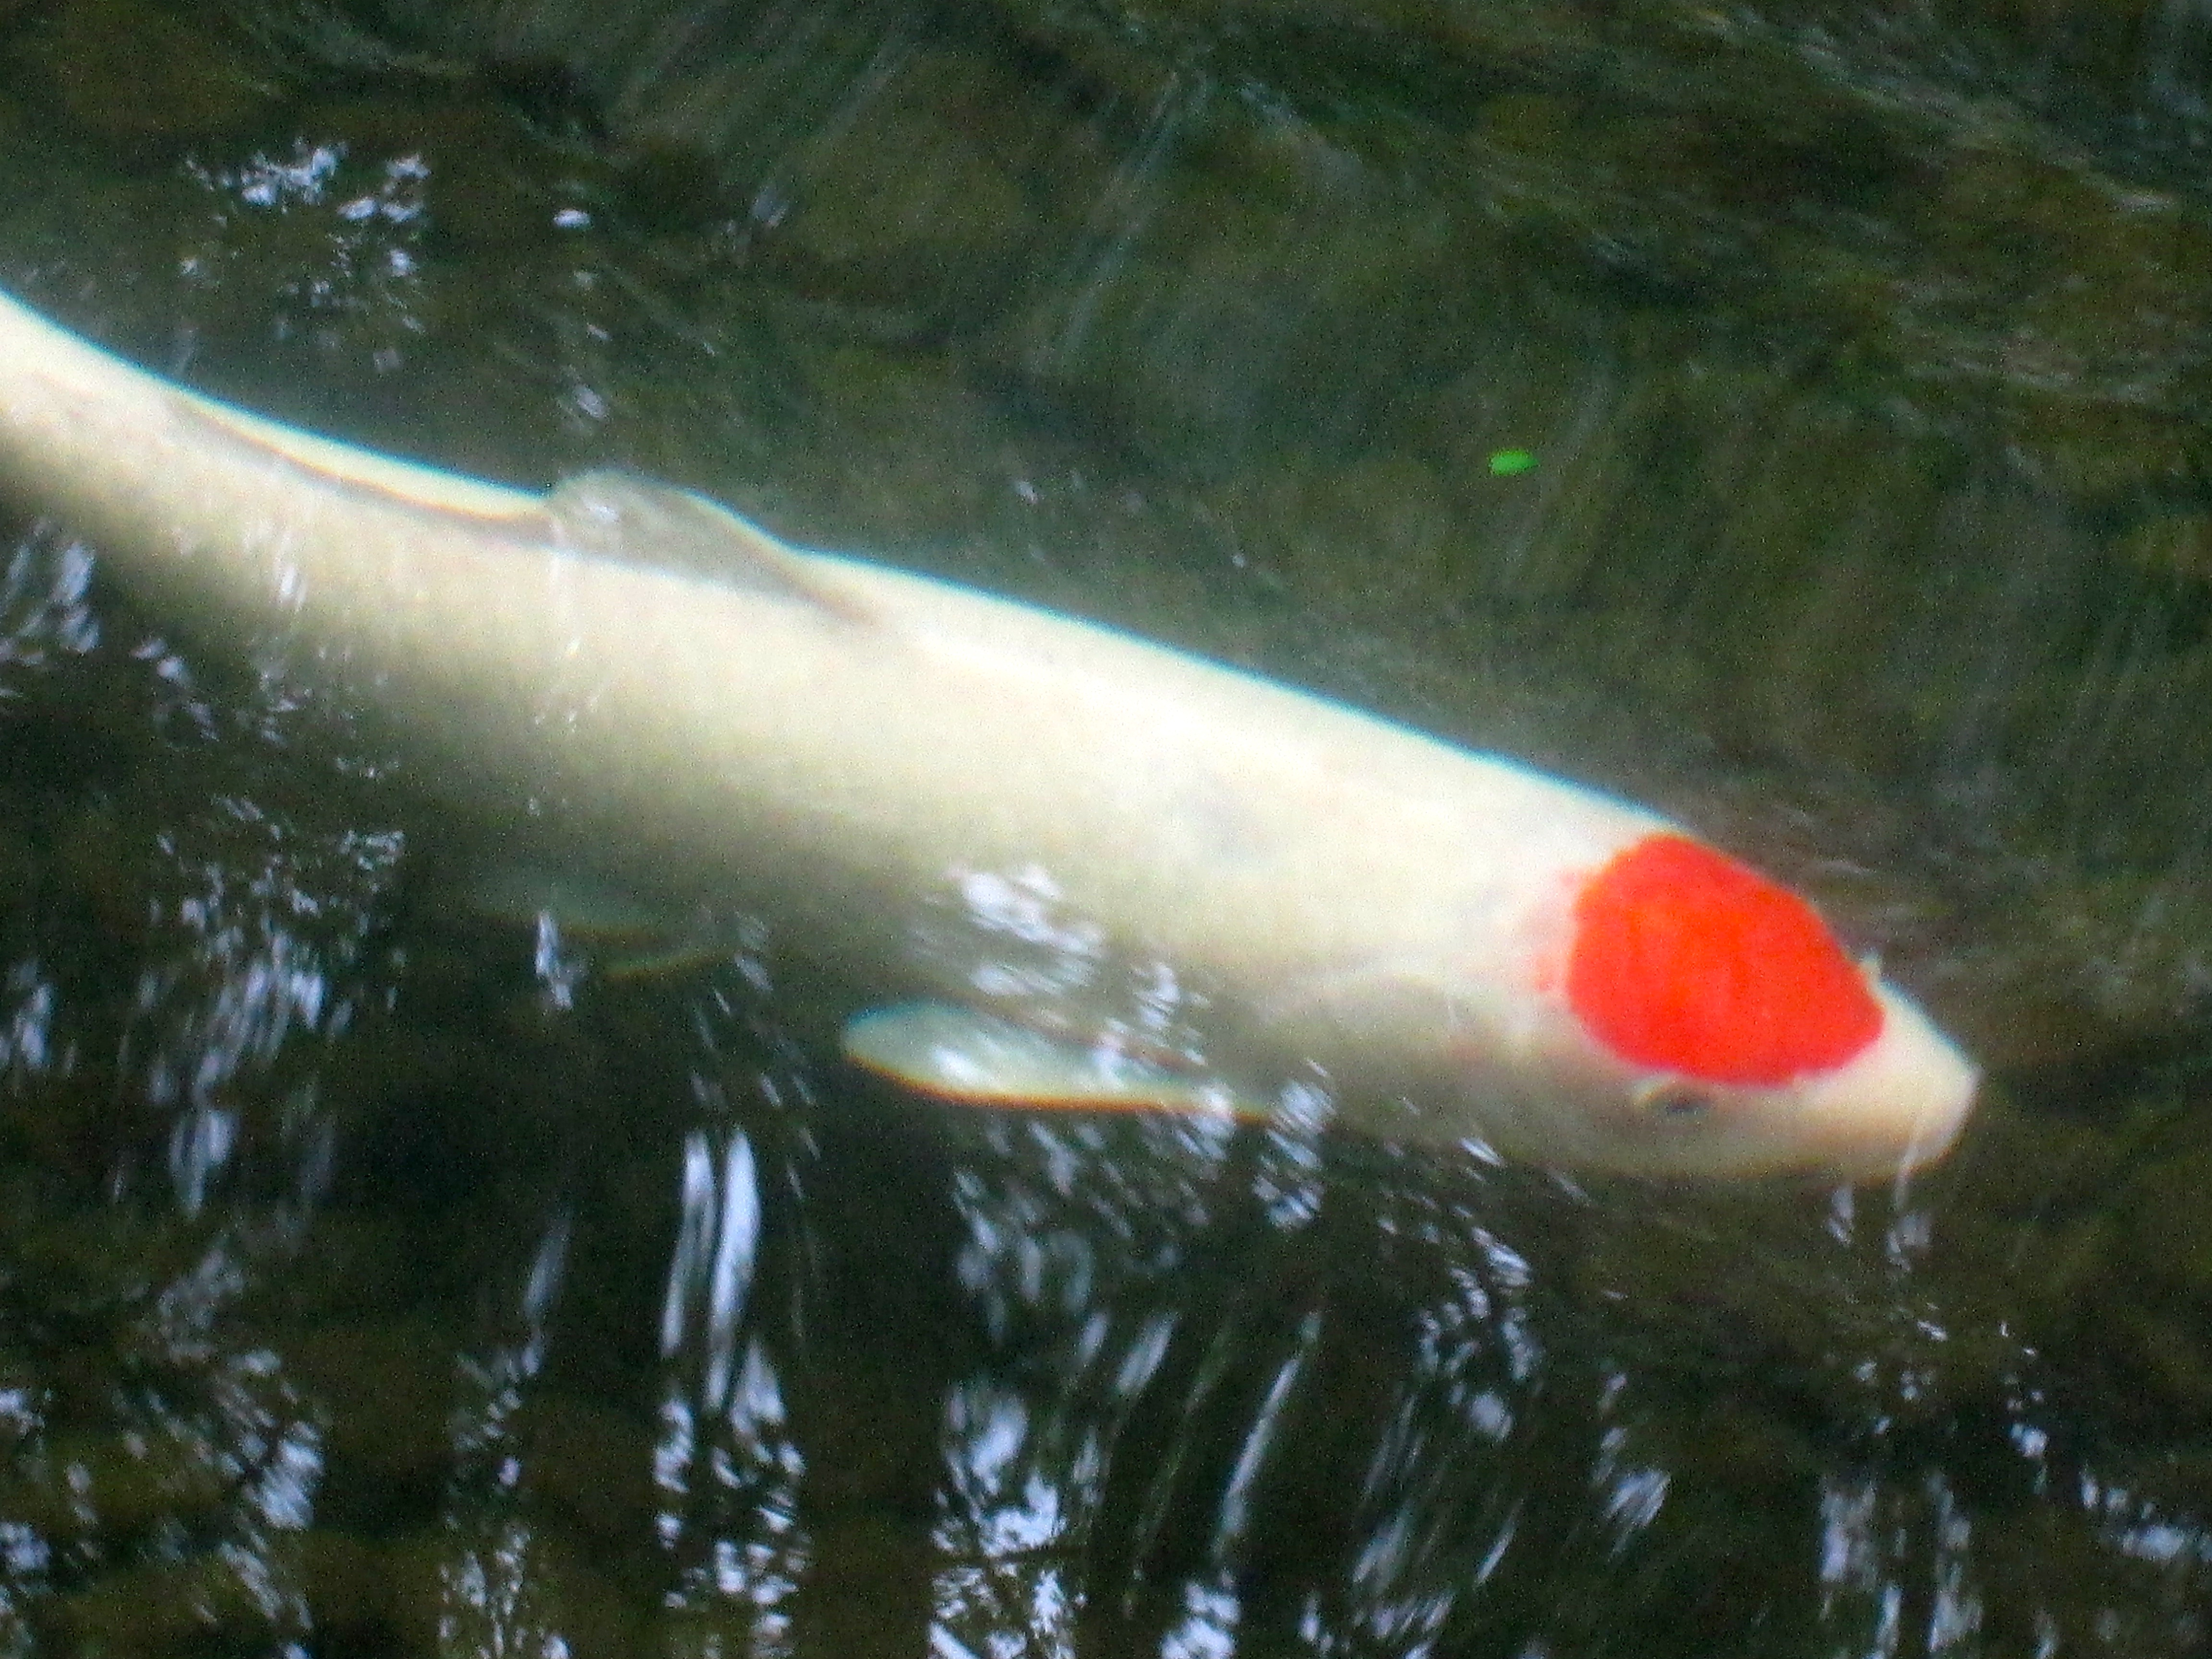
JAPAN (Nippon)
Land of the Rising Sun
⏎ Flag of Japan
Koi fish in
Portland Japanese Garden
⏎

Slide 19
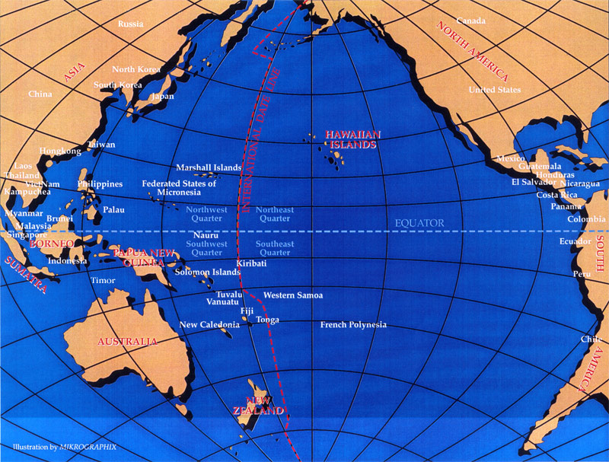
Where in the world is Japan?
OREGON
JAPAN
PACIFIC OCEAN

Slide 20
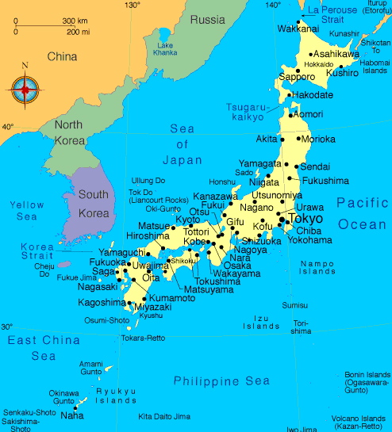
Where in the world is Japan?
ASIA

Slide 21
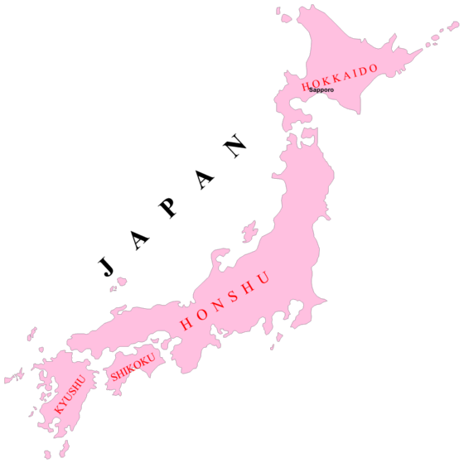
Country of Islands
Japan has more than 2000 islands stretching for nearly 3000 miles. Most Japanese live on 4 major islands:
Hokkaido
Honshu
Shikoku
Kyushu
*Tokyo

Slide 22
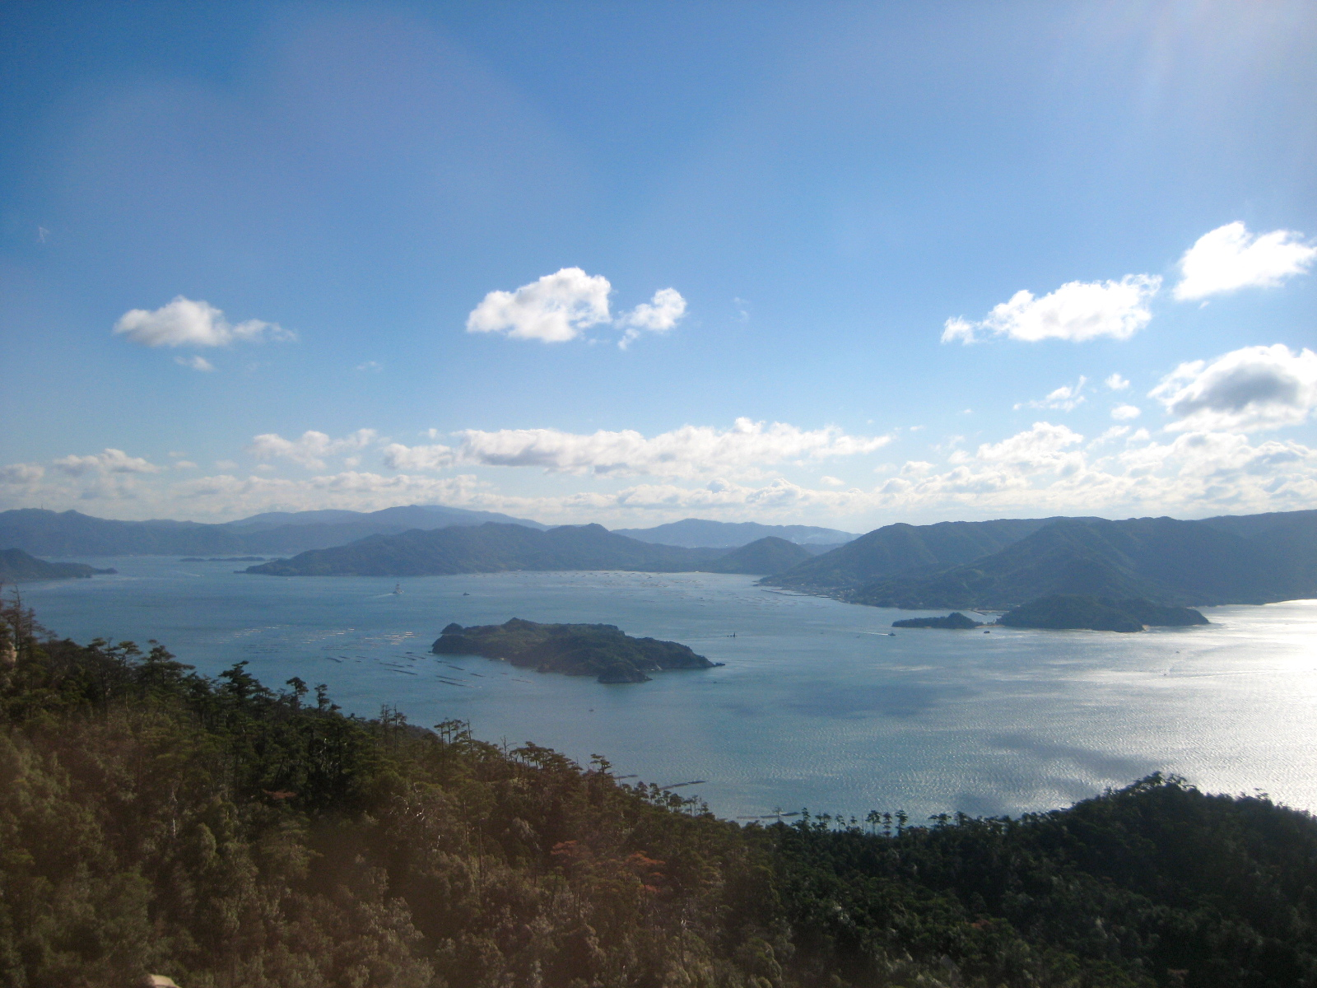
The islands are covered with mountains and forests. Most Japanese live along the coastlines.
People feel close to the cycles of change as the four seasons move across the earth, sea, and sky.

Slide 23
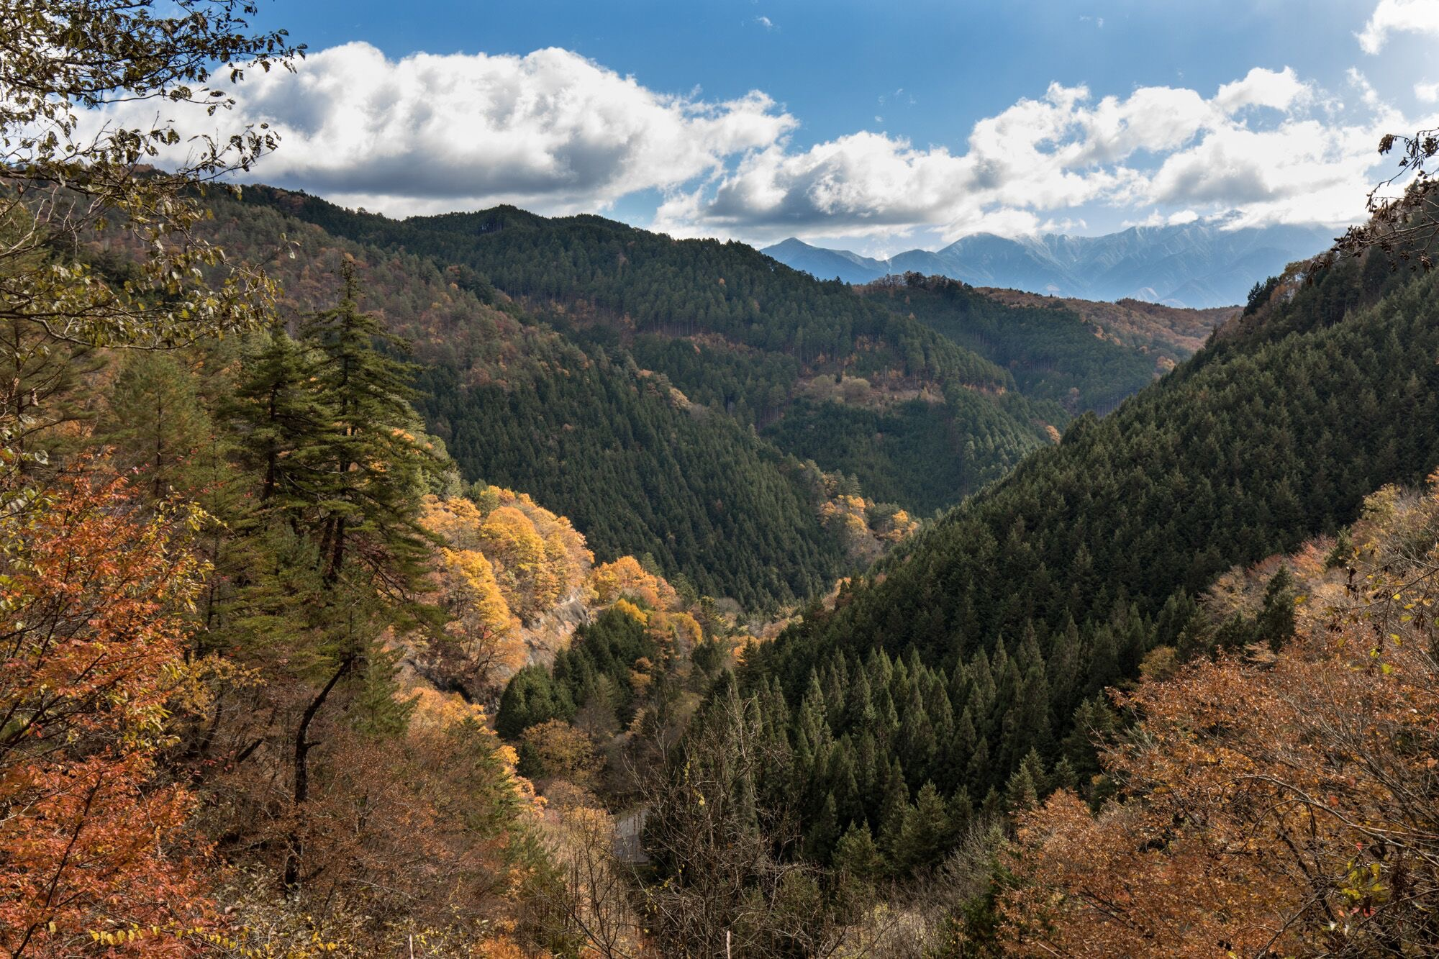
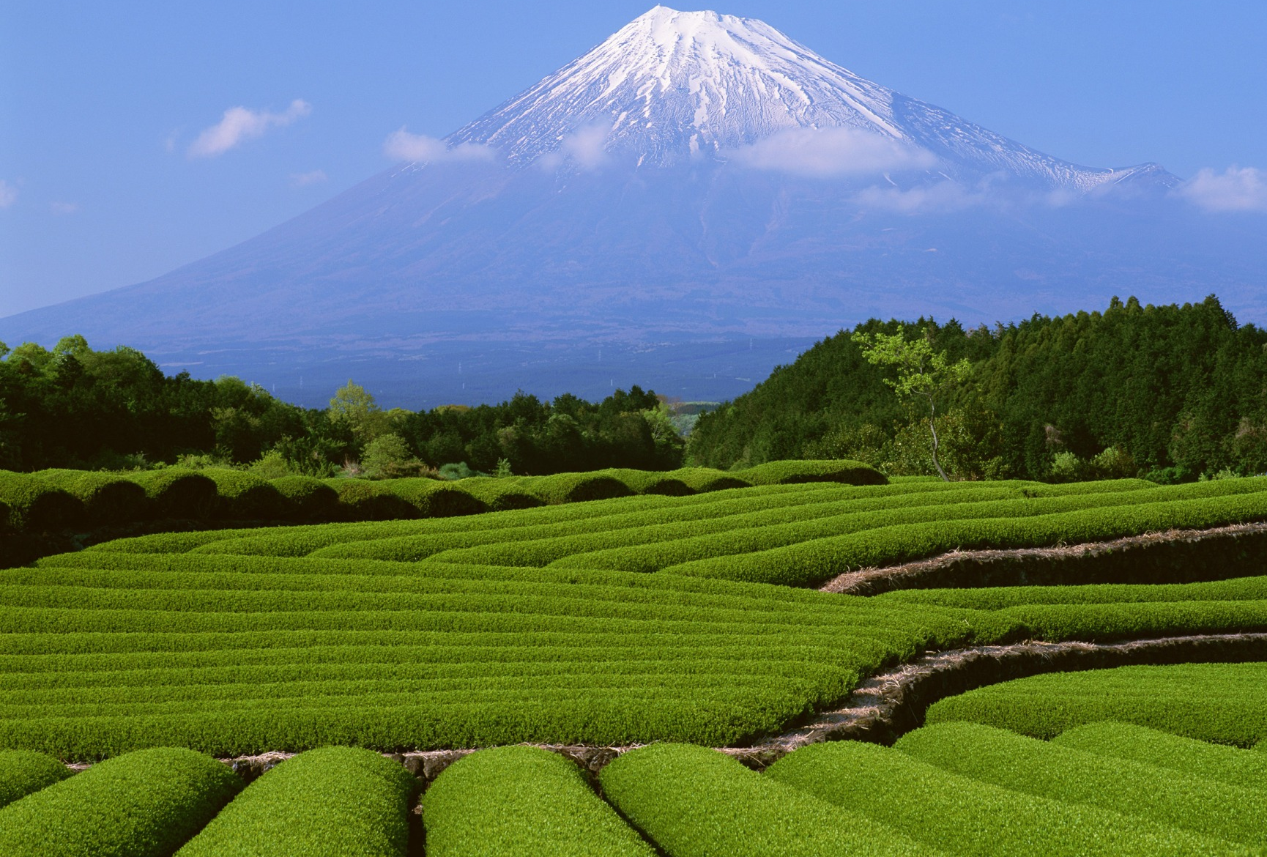
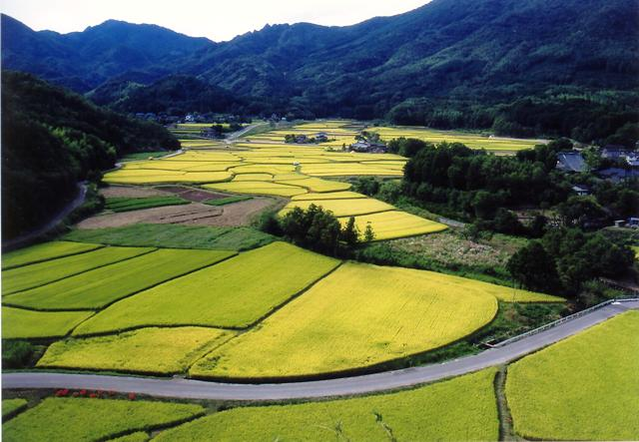
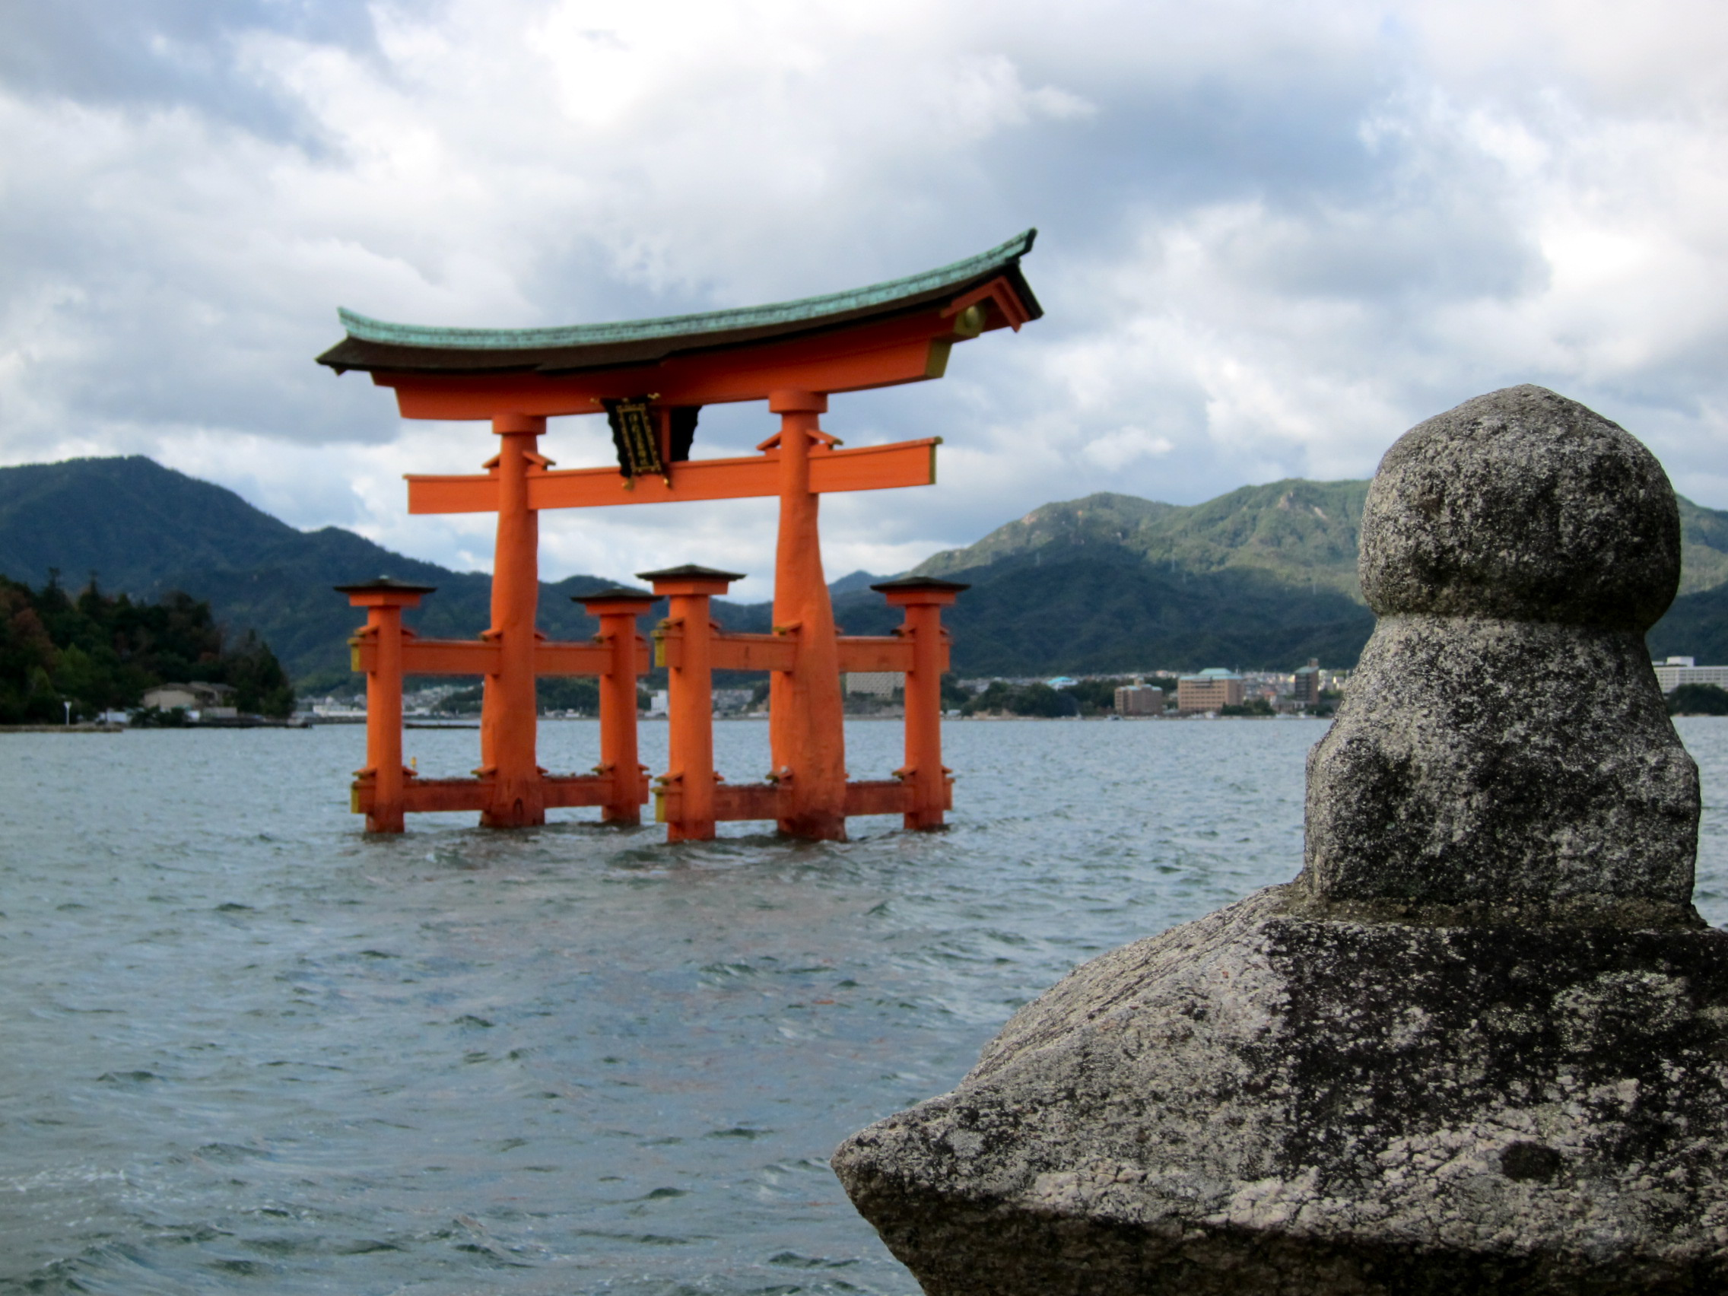

Slide 24
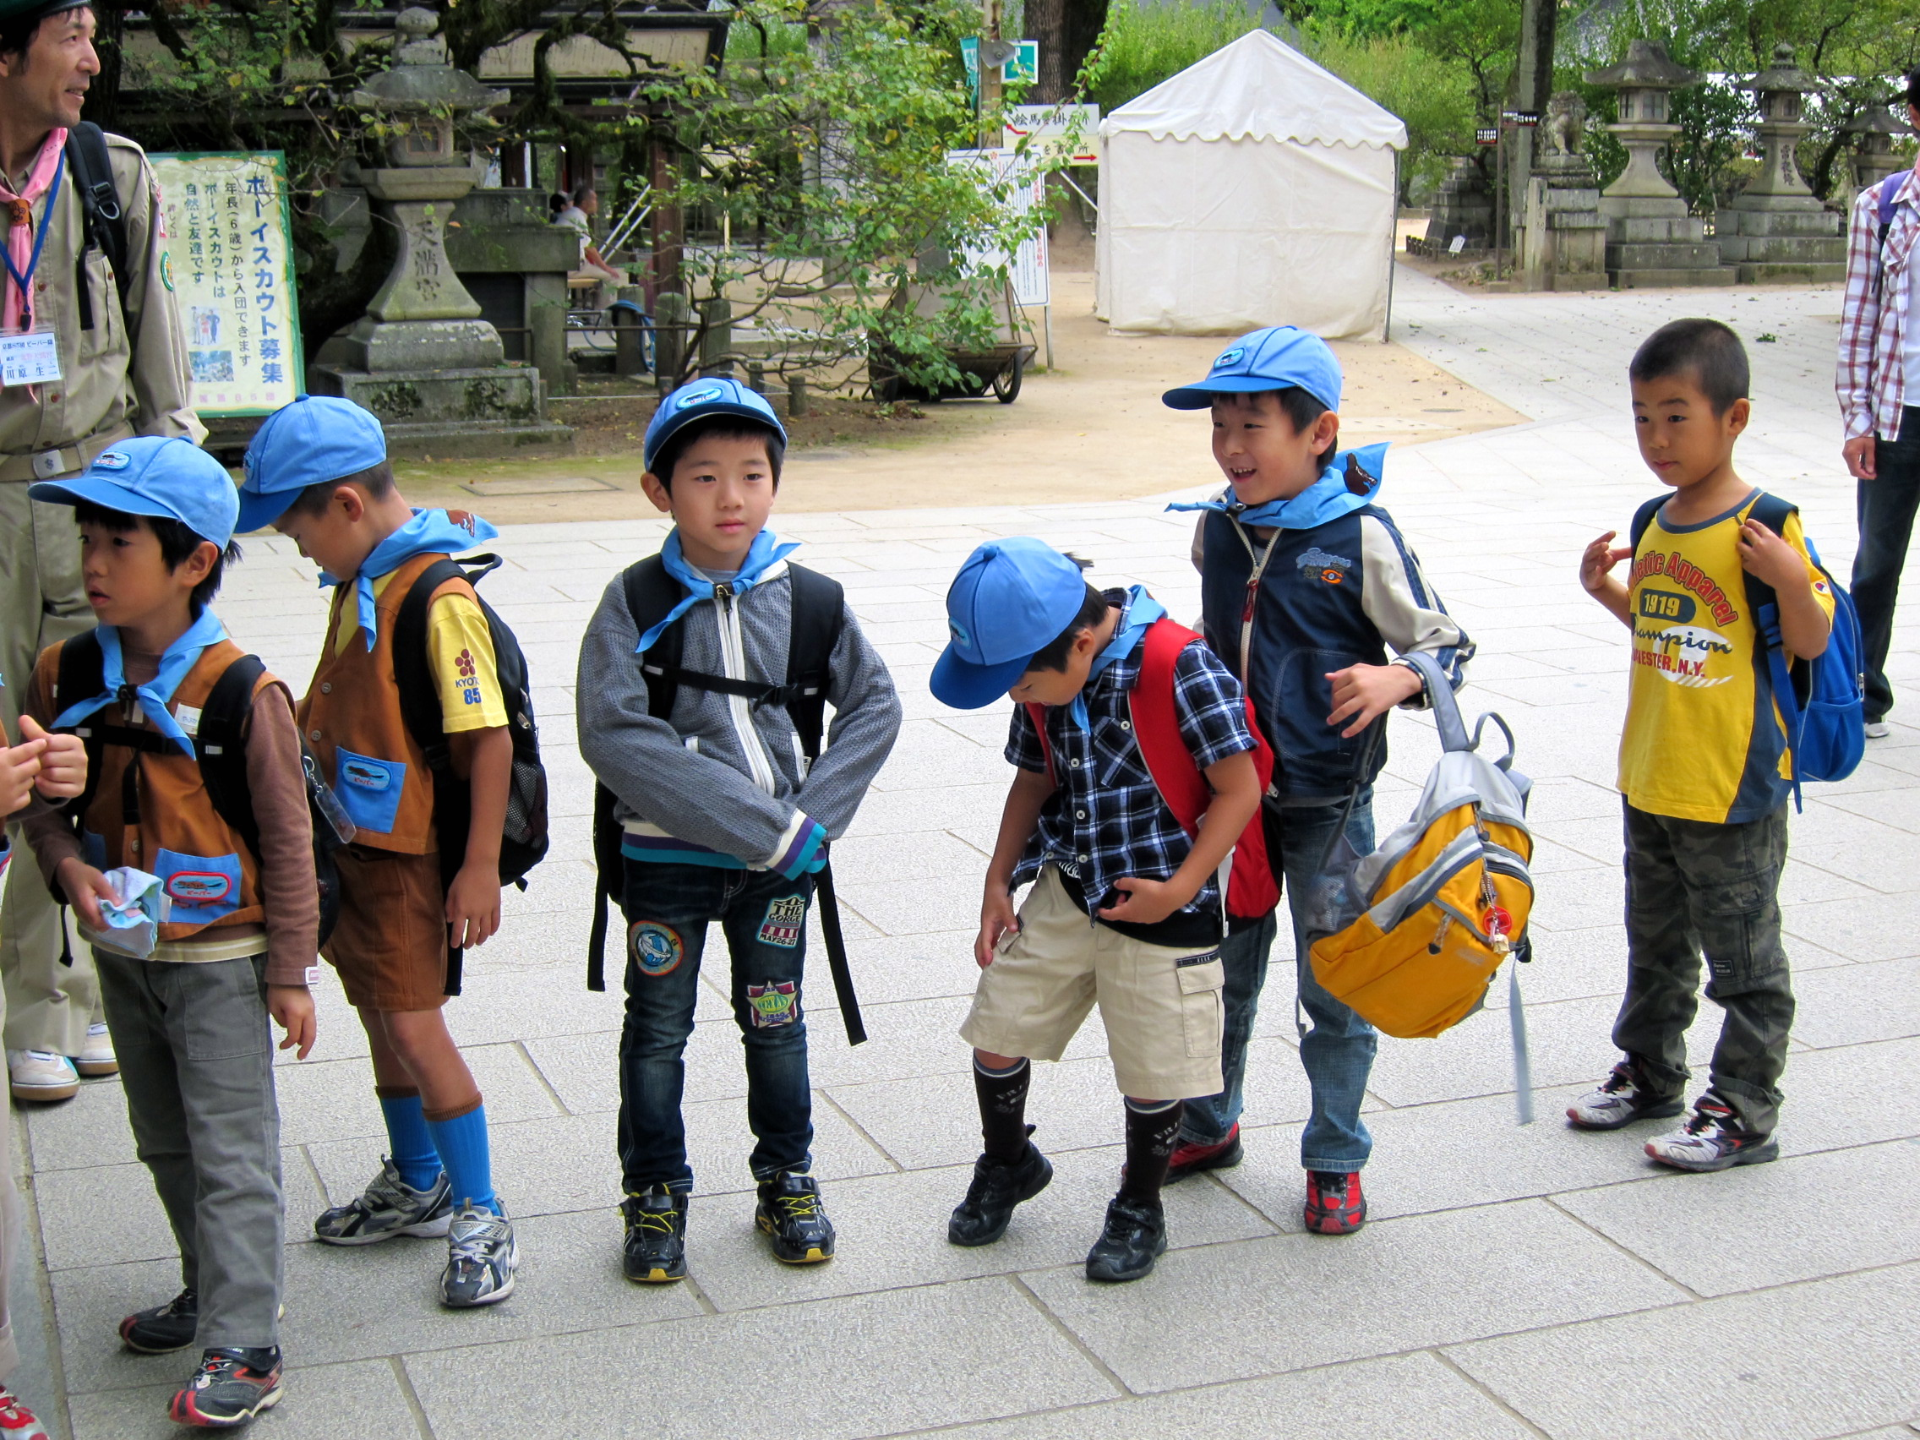
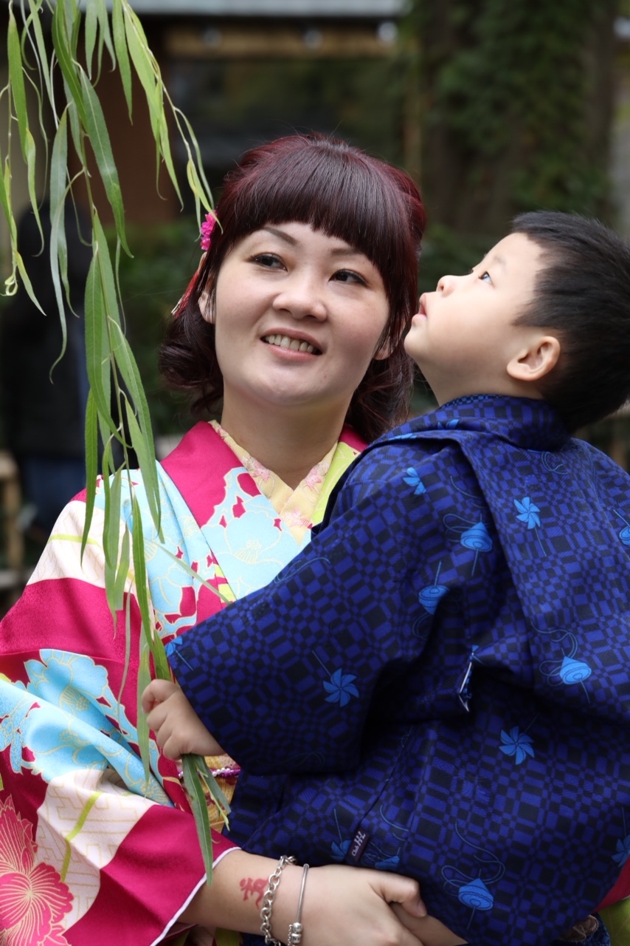
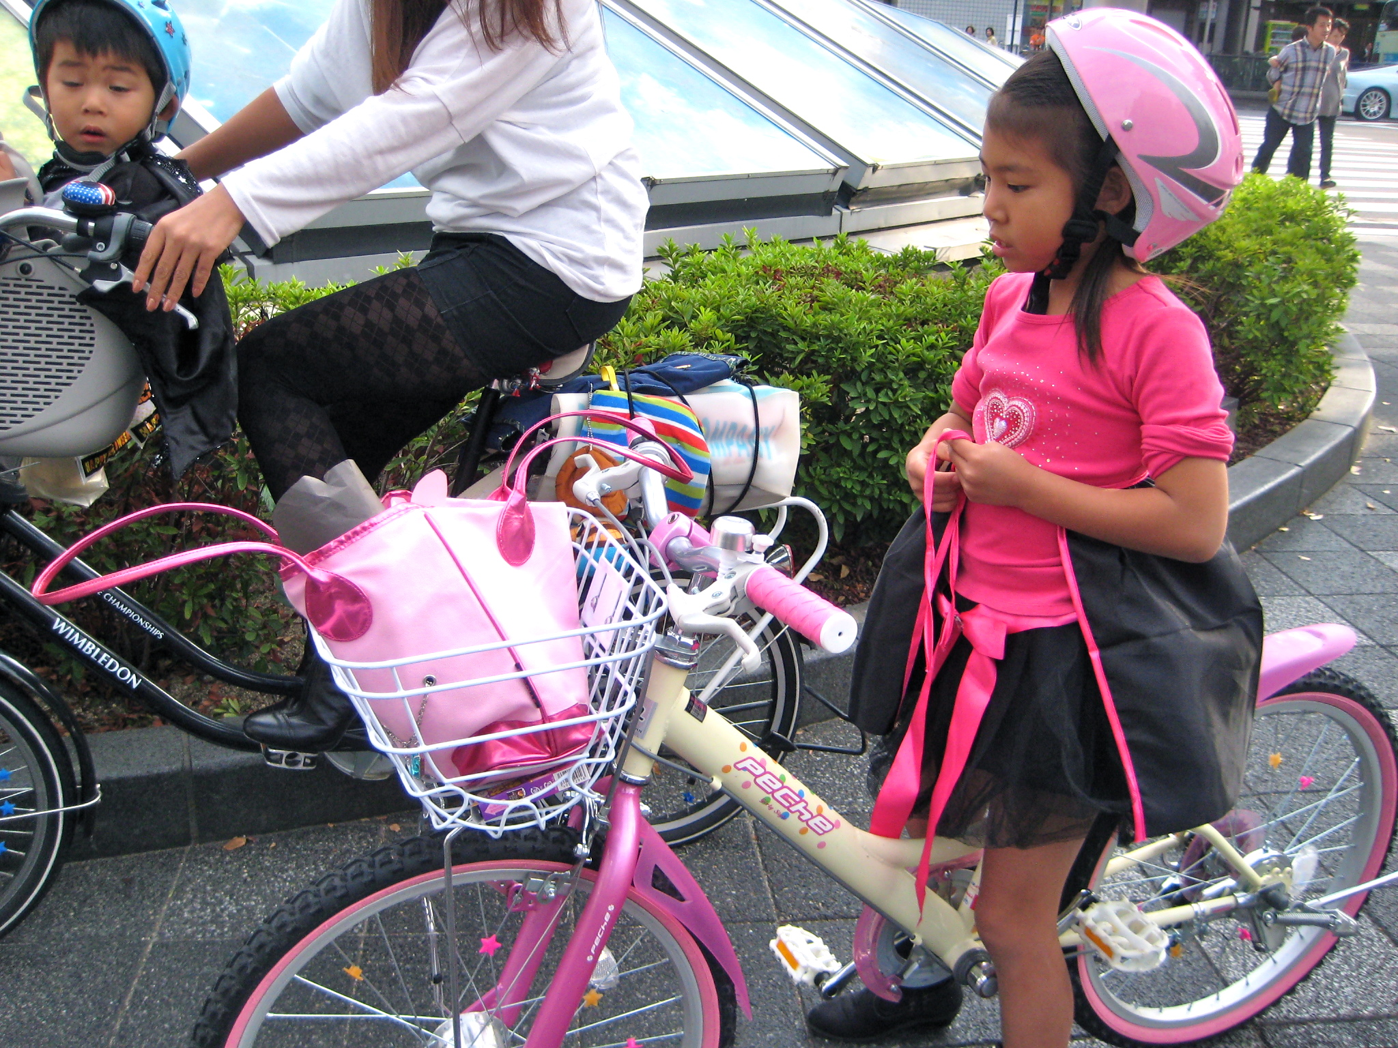
Japanese children grow up loving nature.

Slide 25
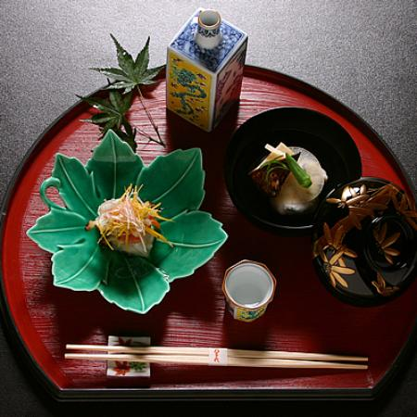
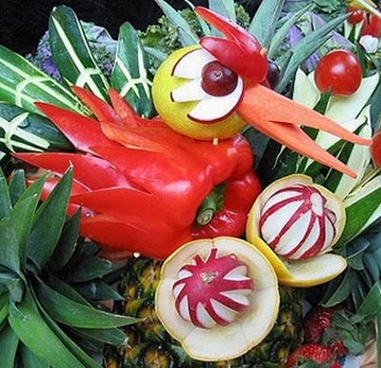
Sea and earth provide fresh, beautiful food each season.
https://www.youtube.com/watch?v=mnhELZjSVXo

Slide 26
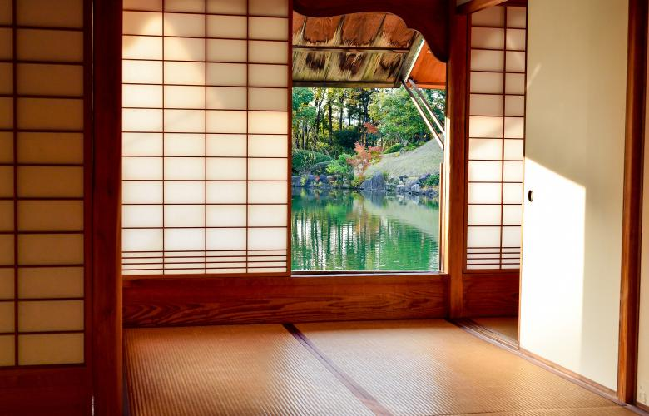
Japanese houses and gardens bring nature into everyday life.

Slide 27
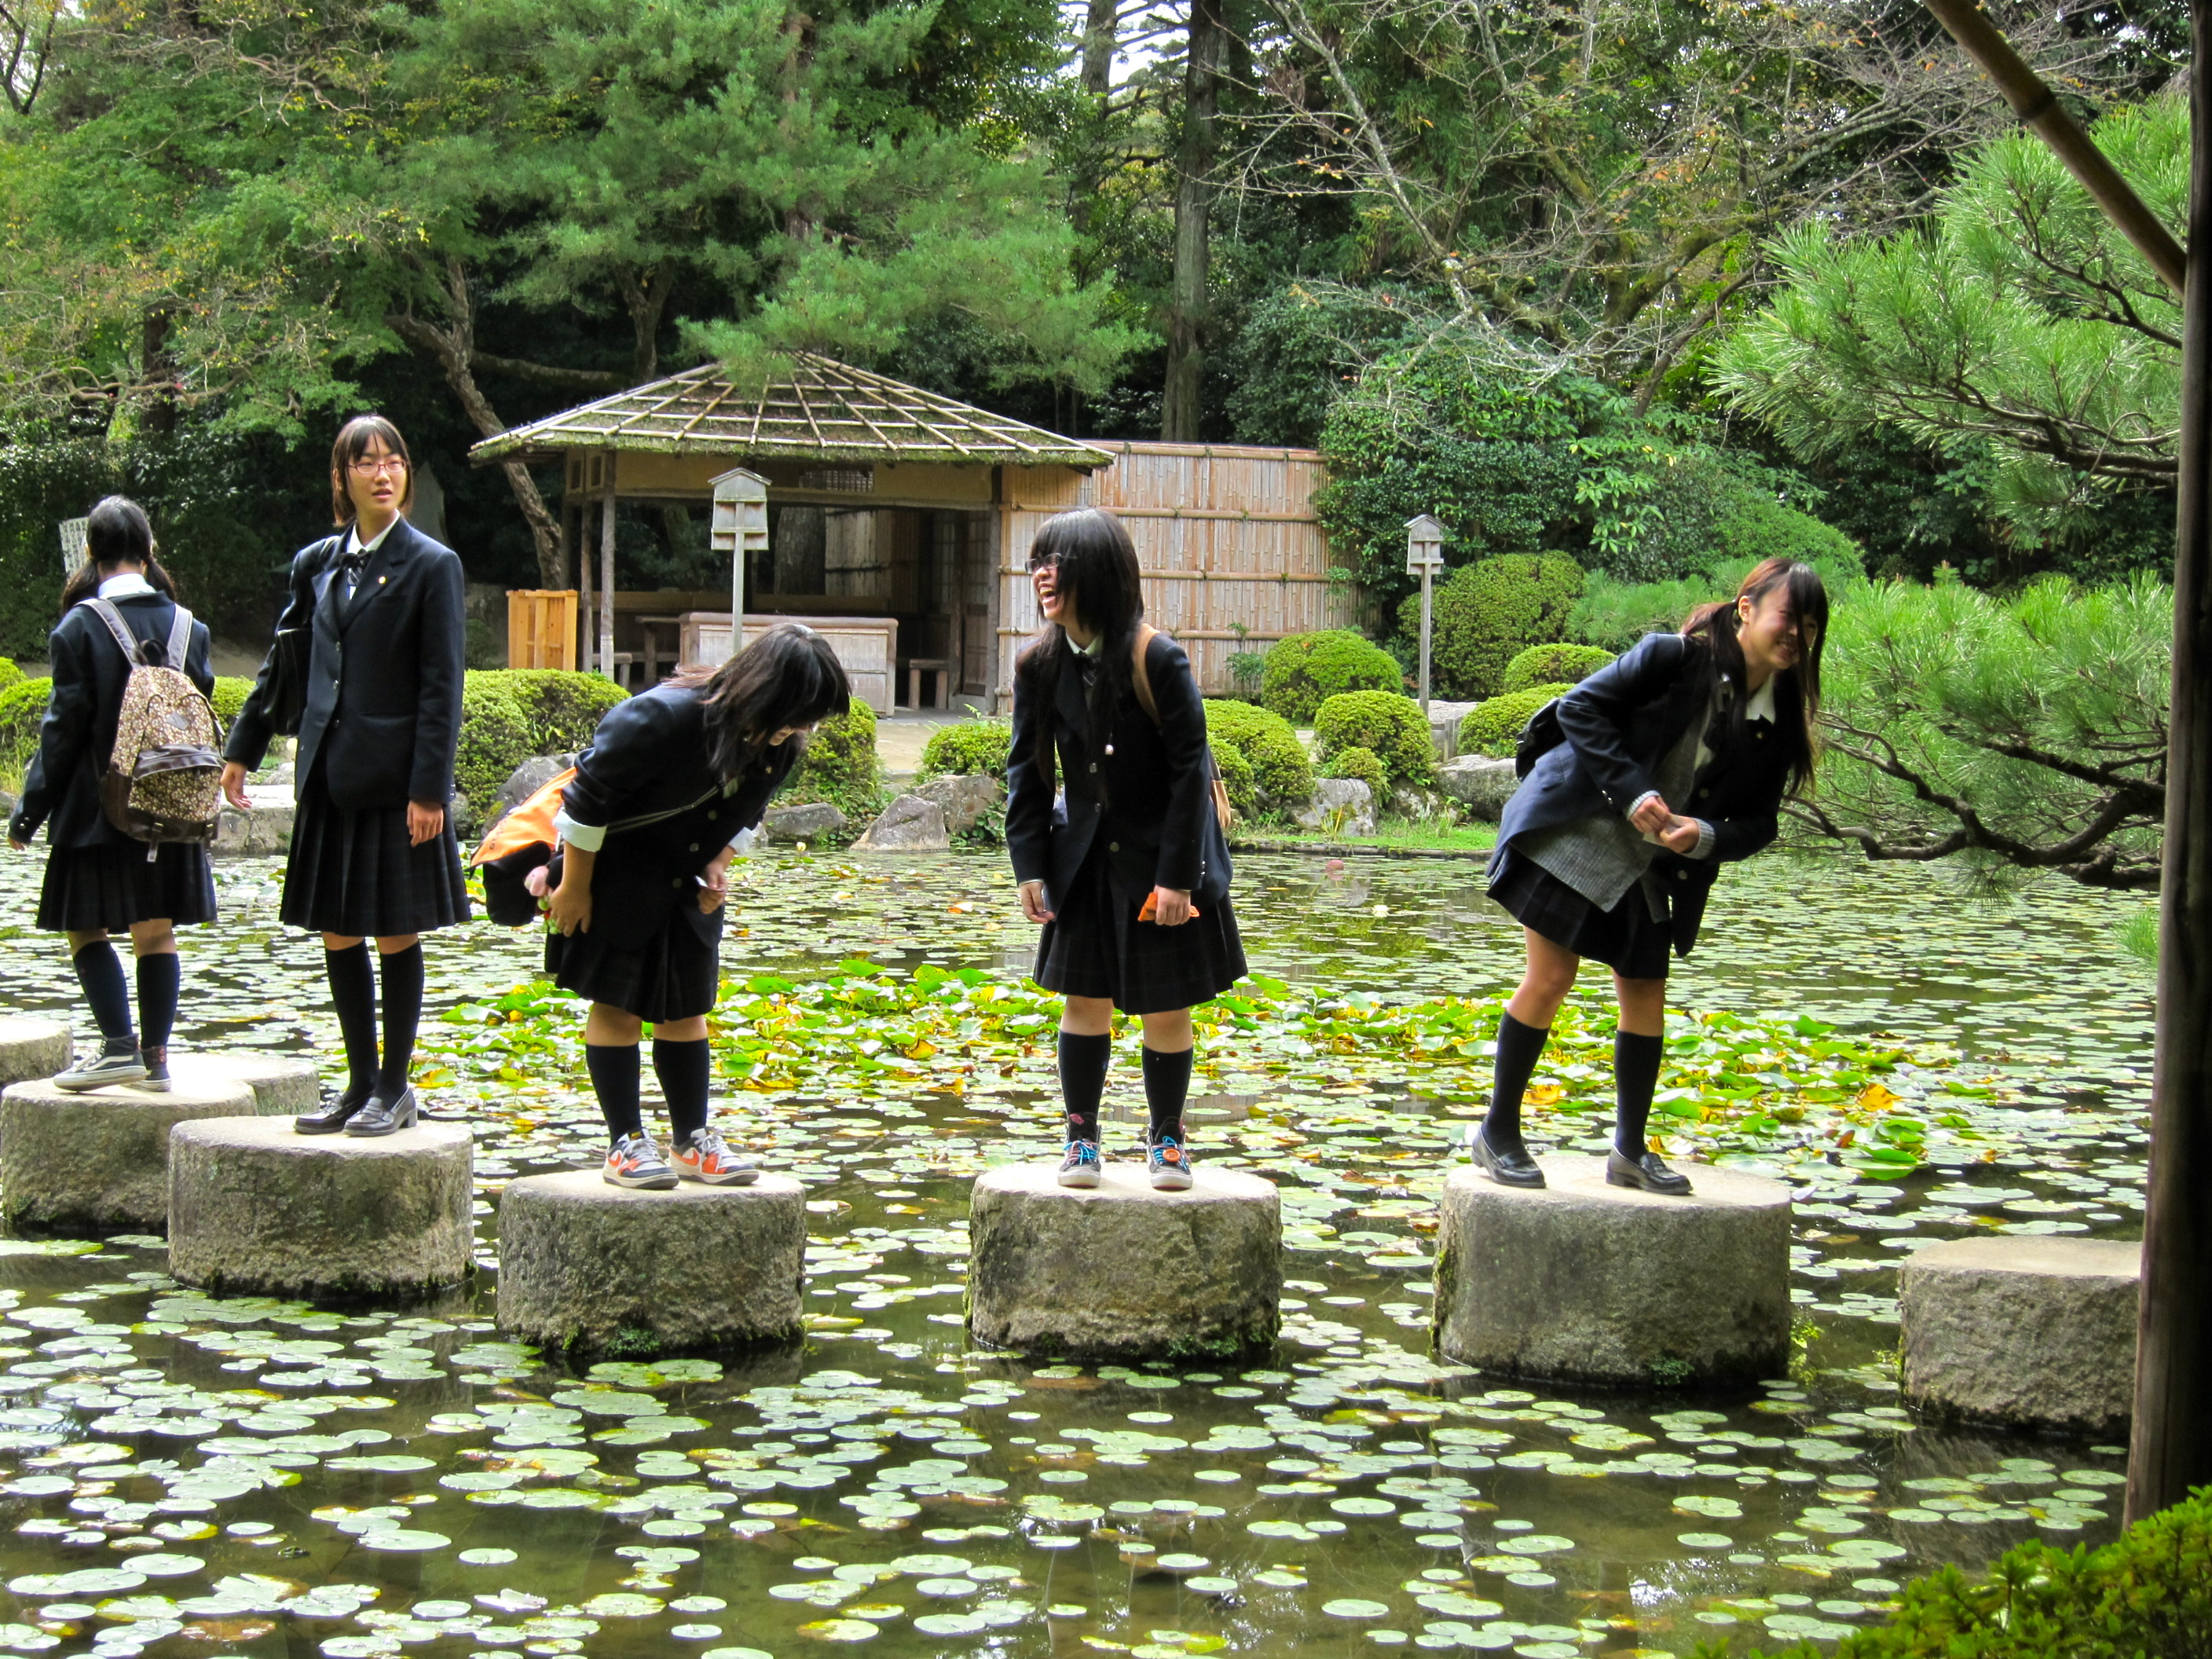
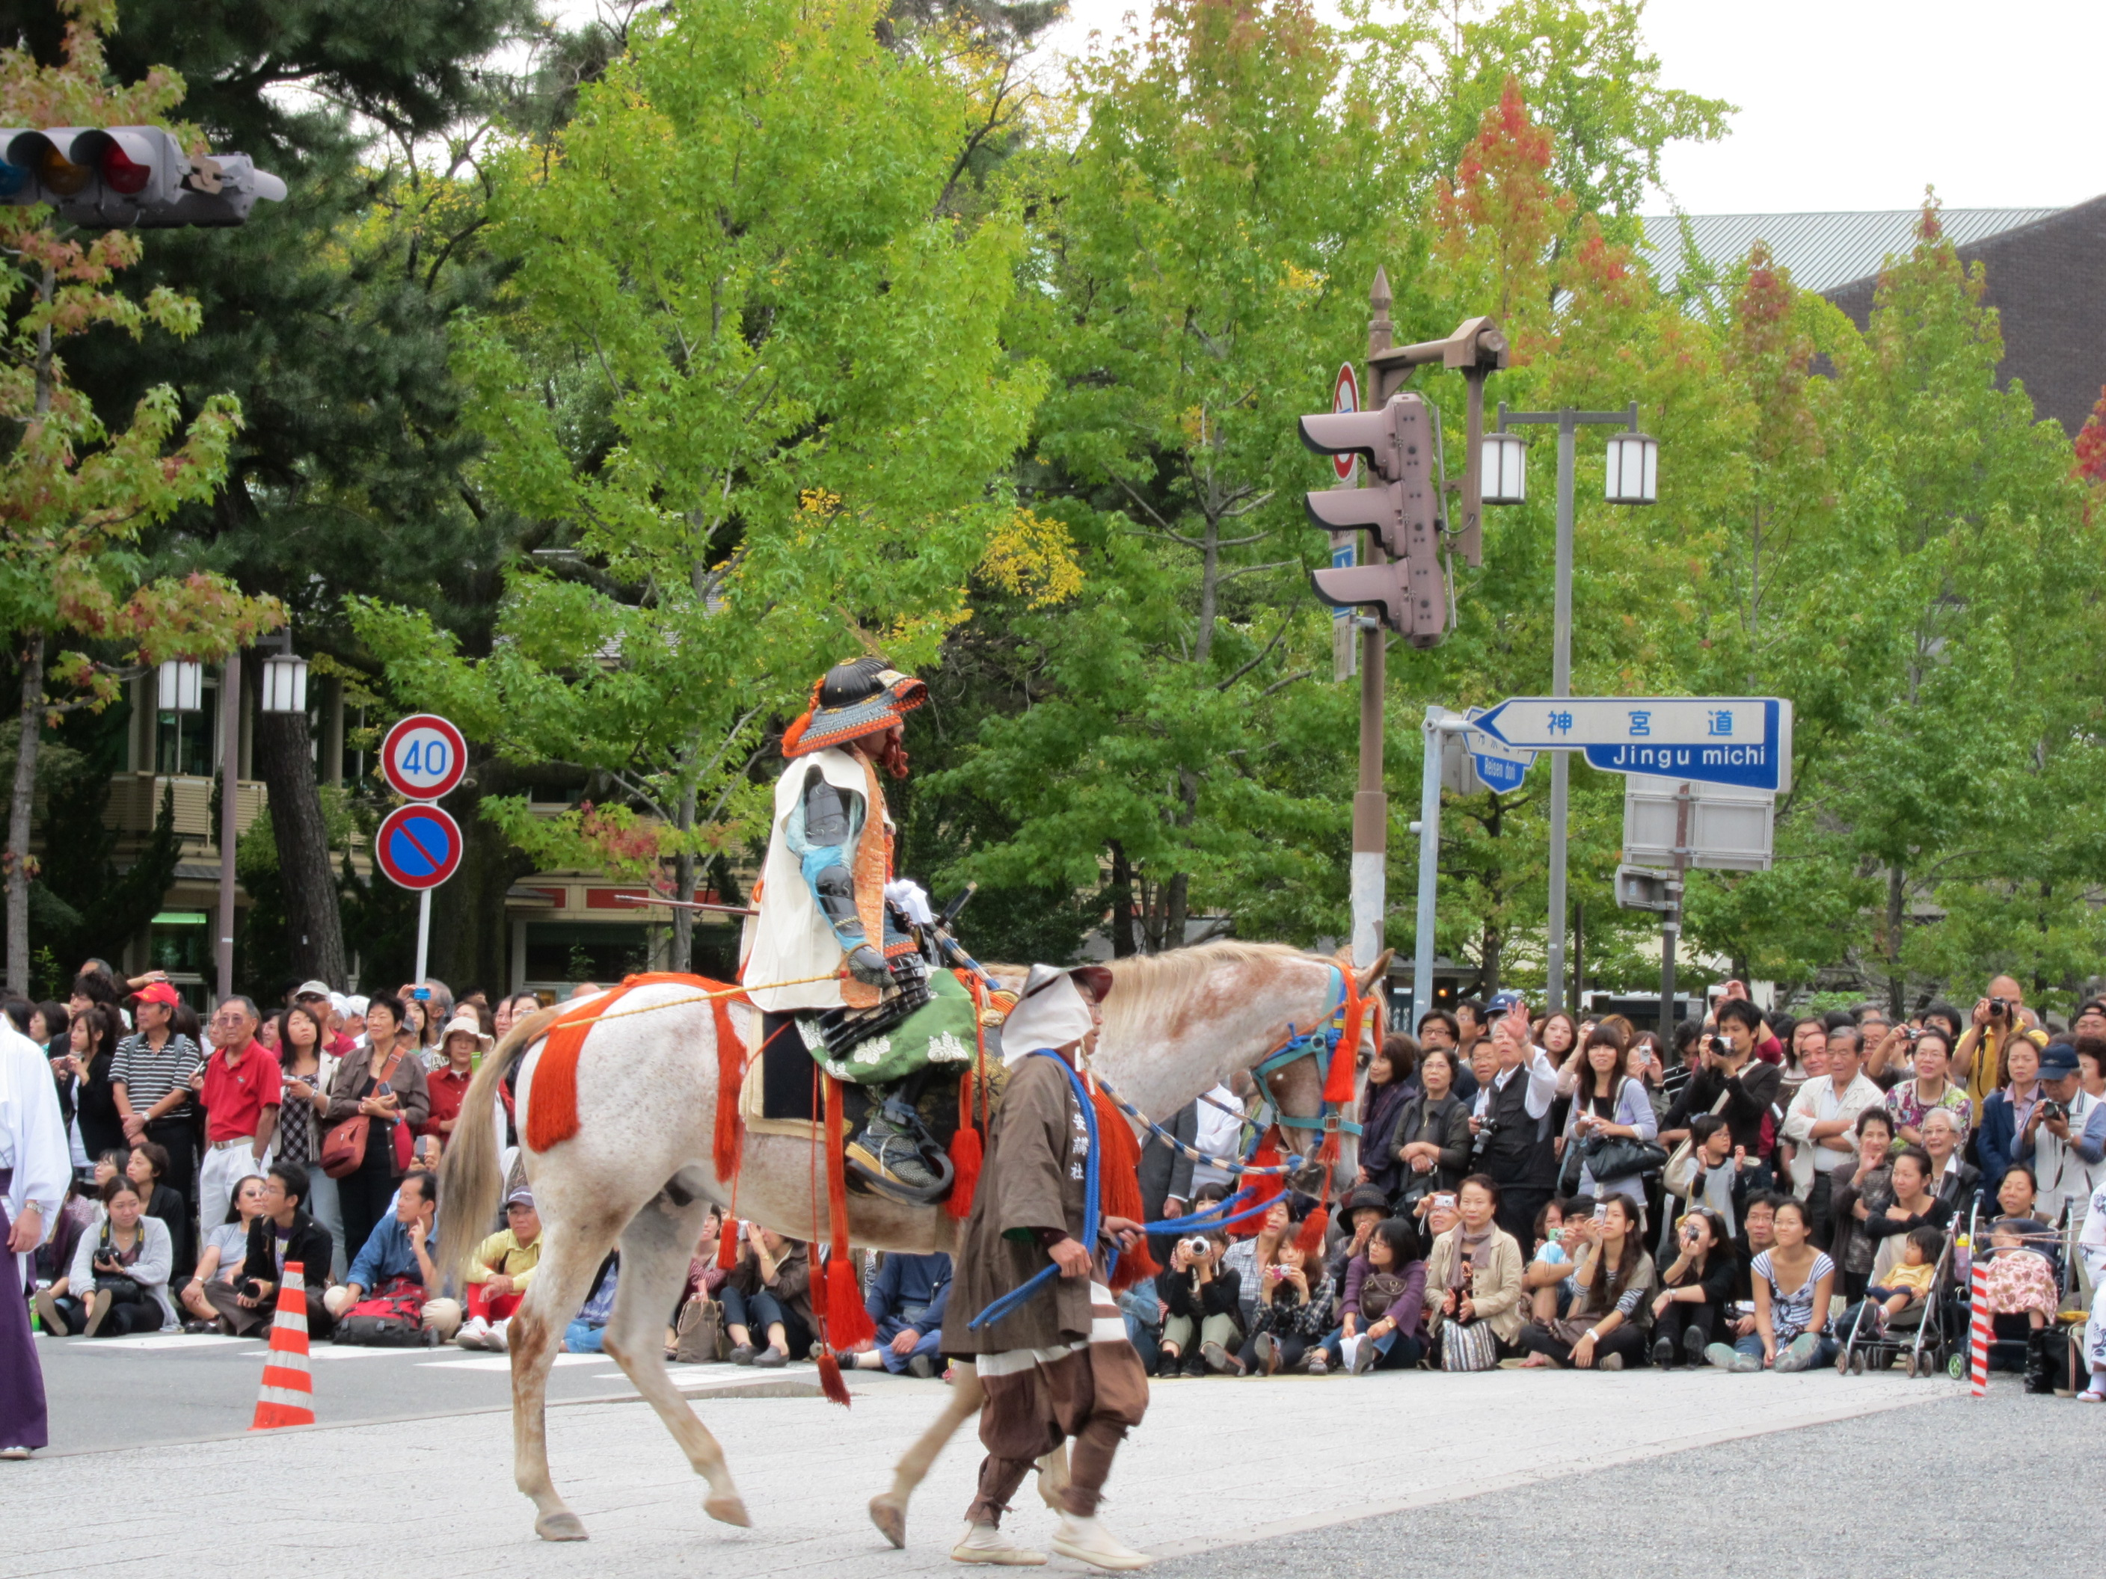
In Japan, each season is celebrated!

Slide 28
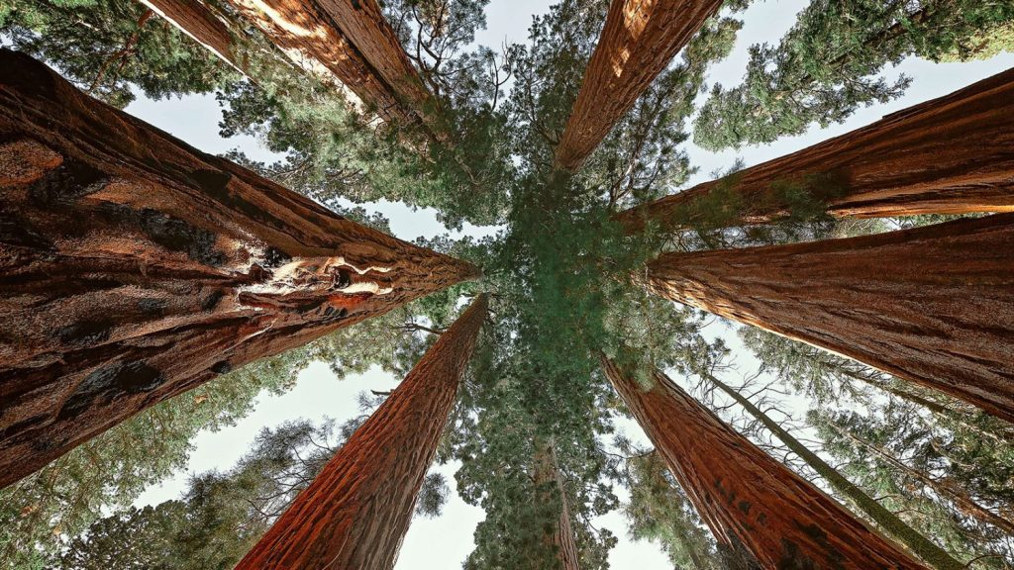
More than 400 years ago, Japanese poets began to write
3-line poems about nature. In haiku, each of the 3 lines is a fresh view of a simple moment when a person meets nature.

Slide 29
Using your five senses, read the haiku…
peaceful forest waves
trees talking, leaves blowing
heart moving in rain
5th grade Haiku Poet
shiny red plants
peace and quiet green leaves
bright sun fall down
3rd grade Haiku Poet
What can you HEAR?
What can you TASTE?
What can you SMELL
What can you SEE?
What can you FEEL and TOUCH?

Slide 30
5 Senses, the Japanese garden
AND YOU!
Practice awakening your senses!
SEE
Colors—gold, red, shiny green
Shapes—round, curves, ripples, reflection
Objects—petals, leaf, waterfalls, bridge
Size and distance—big, small, far, close
TASTE
Tastes can be real or imagined: spring, summer, fall, winter,
fresh, green, rain-soaked, mud, water, earth, tea, Japan
HEAR
Distance—far away, close by, zoom in
Volume—hush, quiet, loud, screams
Sounds—rushing, chirping, peace and harmony, drips, splash, rustle, crunch
TOUCH and FEEL
Smooth, rough, sharp, bumpy, slippery, dry, chilly, cold, warm, hot, wet, damp, soaking, slick, peace, tranquility, balance, friendship, together, protect, guard, harmony, quiet, sad, longing
SMELL
sweet, stinky, fresh, moldy, flowery, tingly, sharp, sour, wet, mossy, woodsy

Slide 31
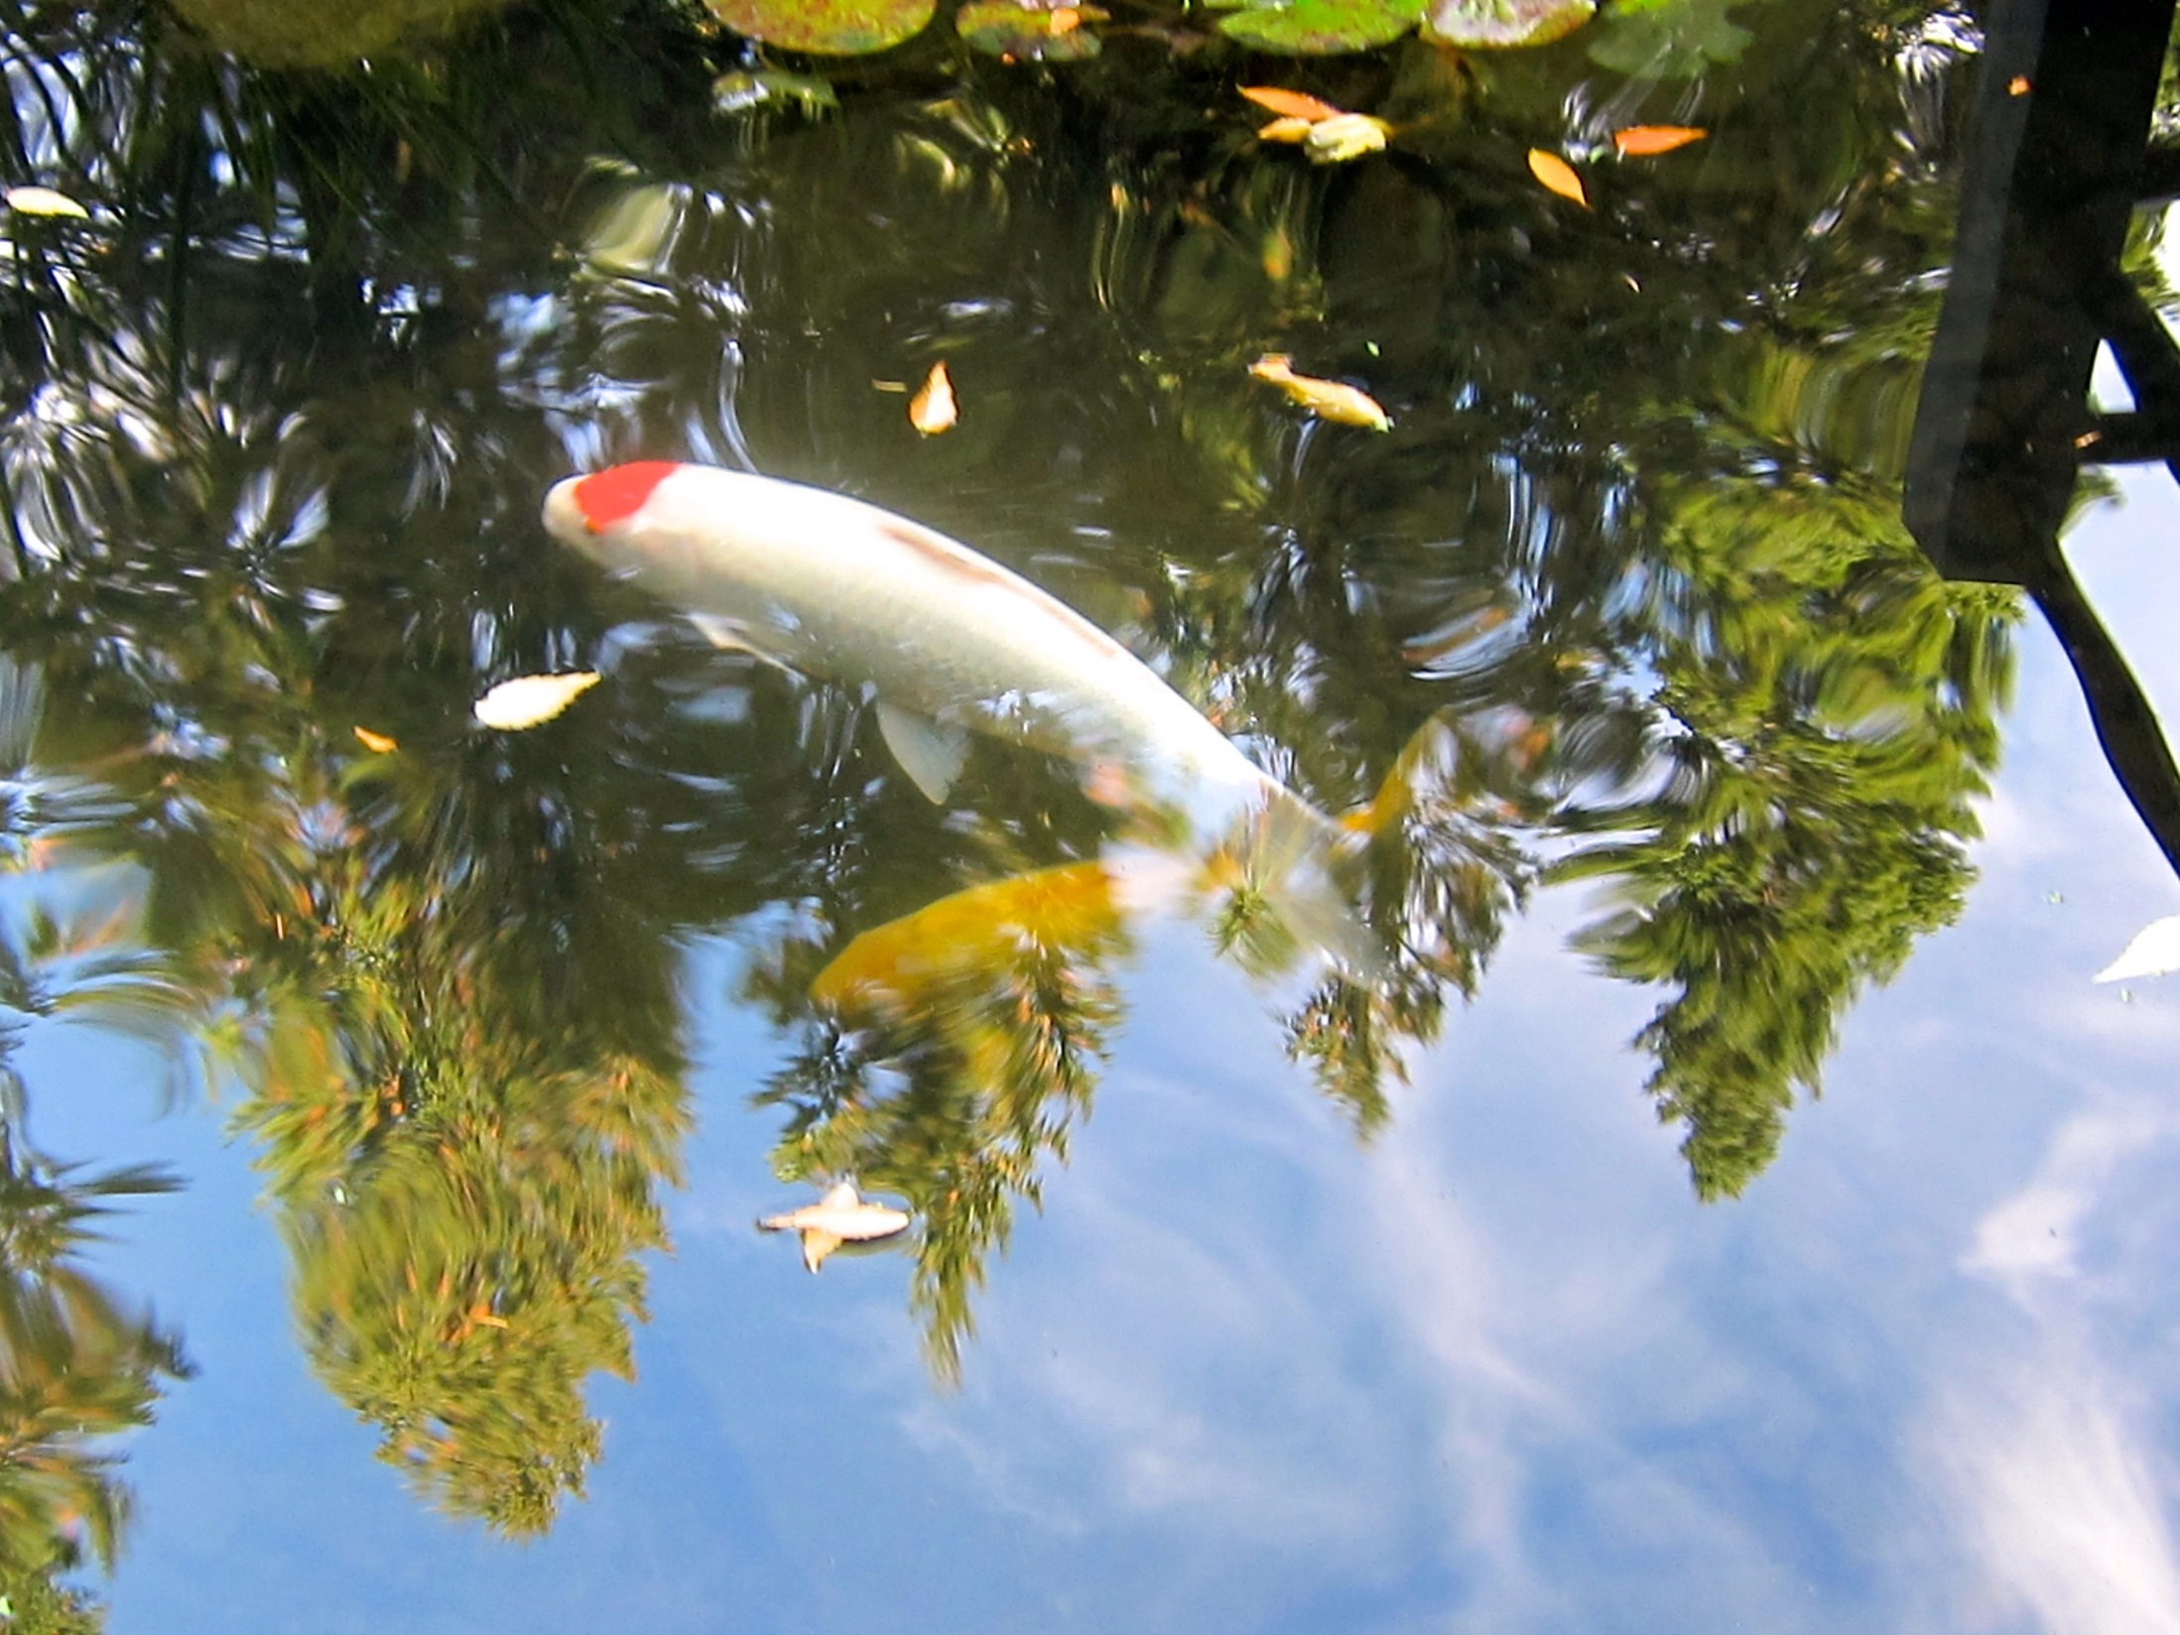

Slide 32
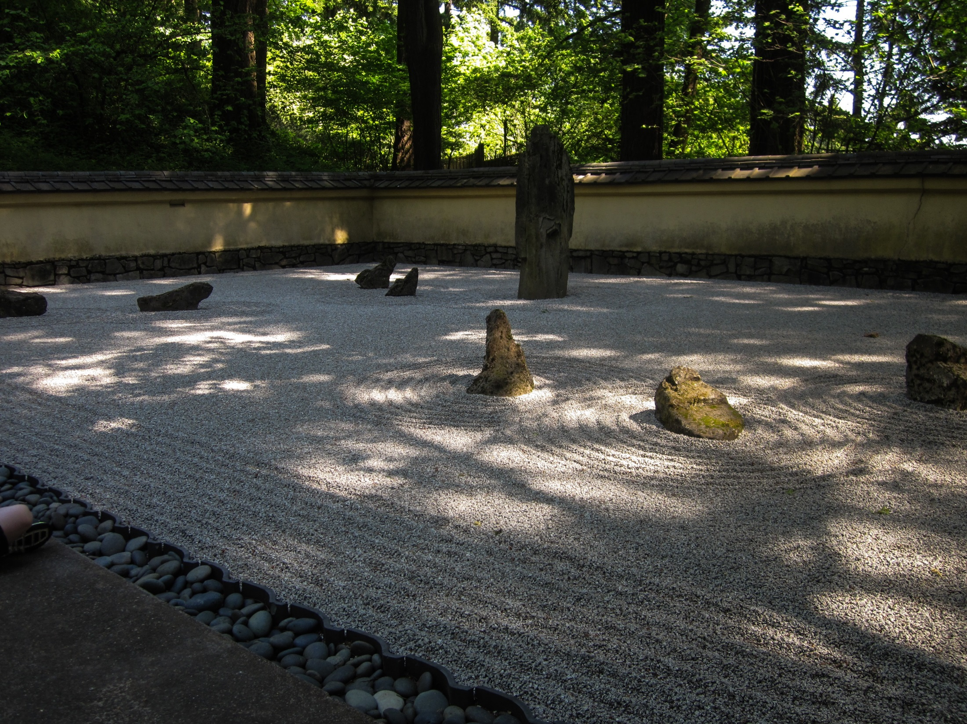

Slide 33
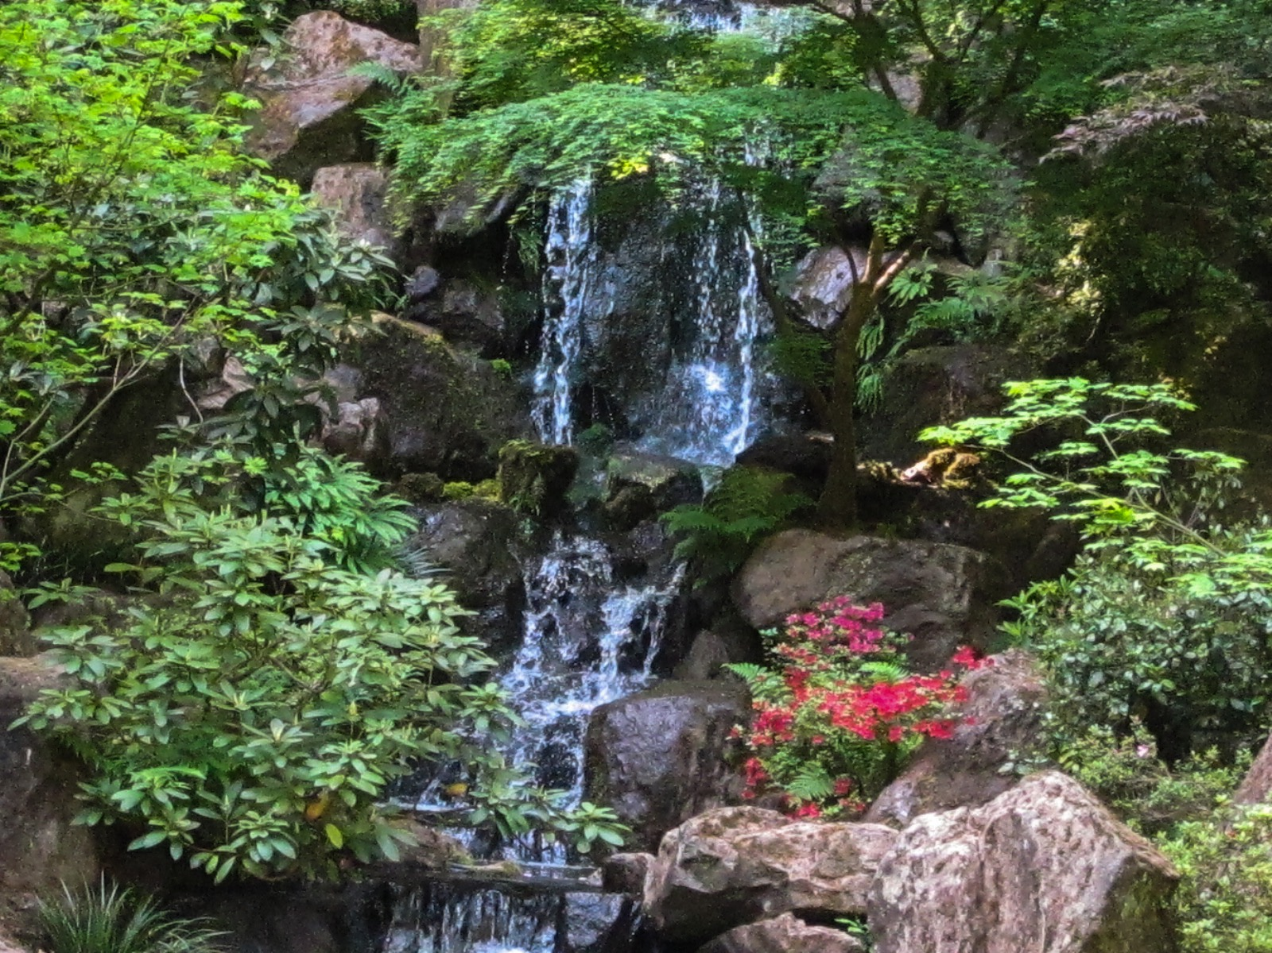

Slide 34
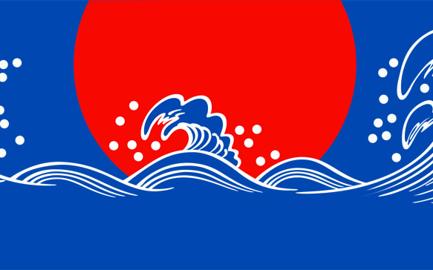
Living in harmony with nature
in Japanese culture and around the world
WHERE DO YOU GO TO BE IN NATURE?
What does nature mean to you?

Slide 35
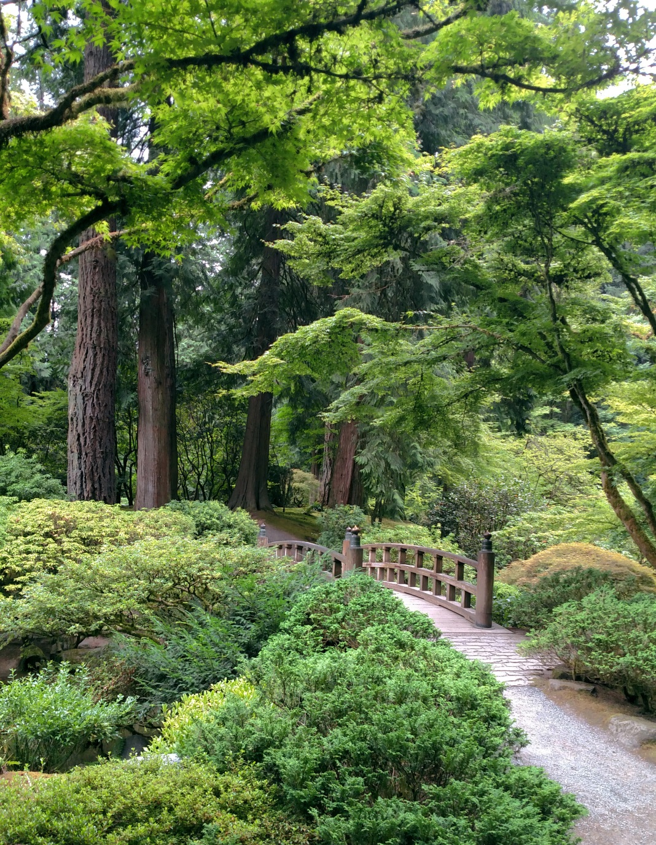
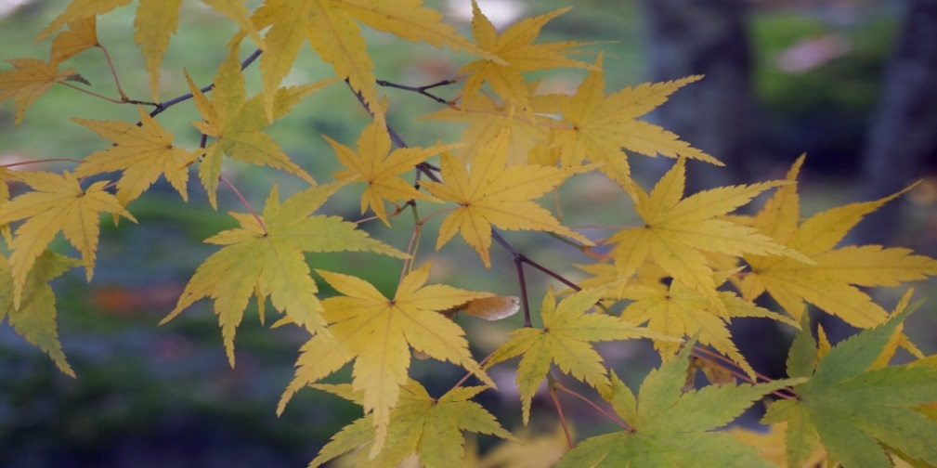
Portland Japanese Garden
extends gratitude to
PGE Foundation and
FAO Schwarz Family Foundation
for generous funding to bring
HAIKU ALIVE

