Slide 1
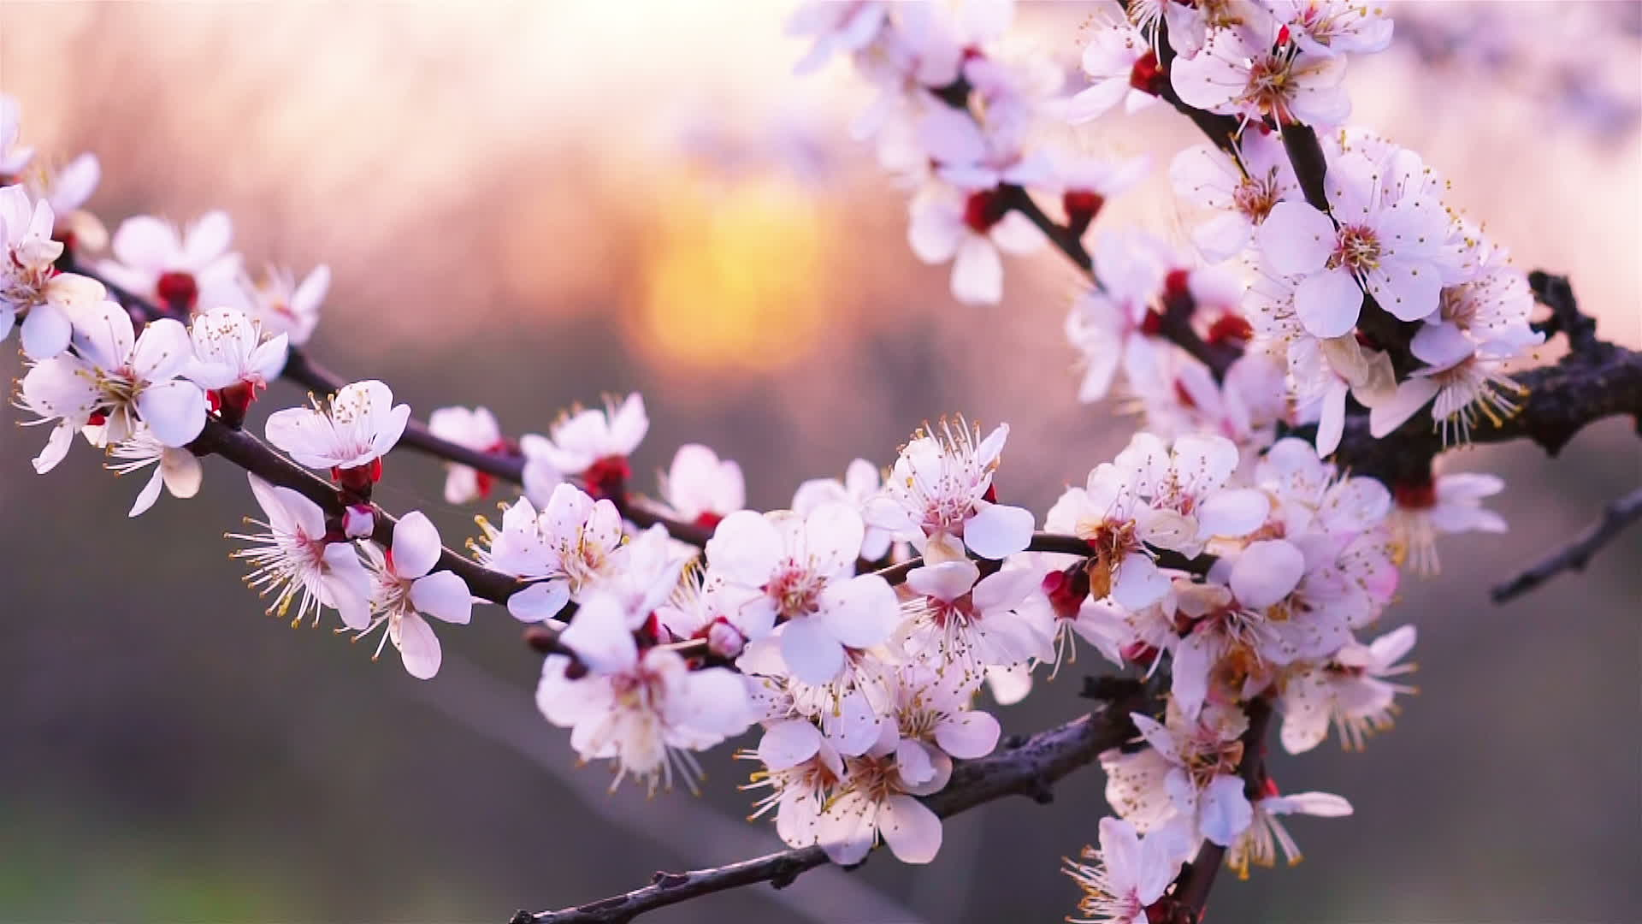
Haiku Alive:
Sakura
Let’s write haiku with help from spring and cherry blossoms

Slide 2
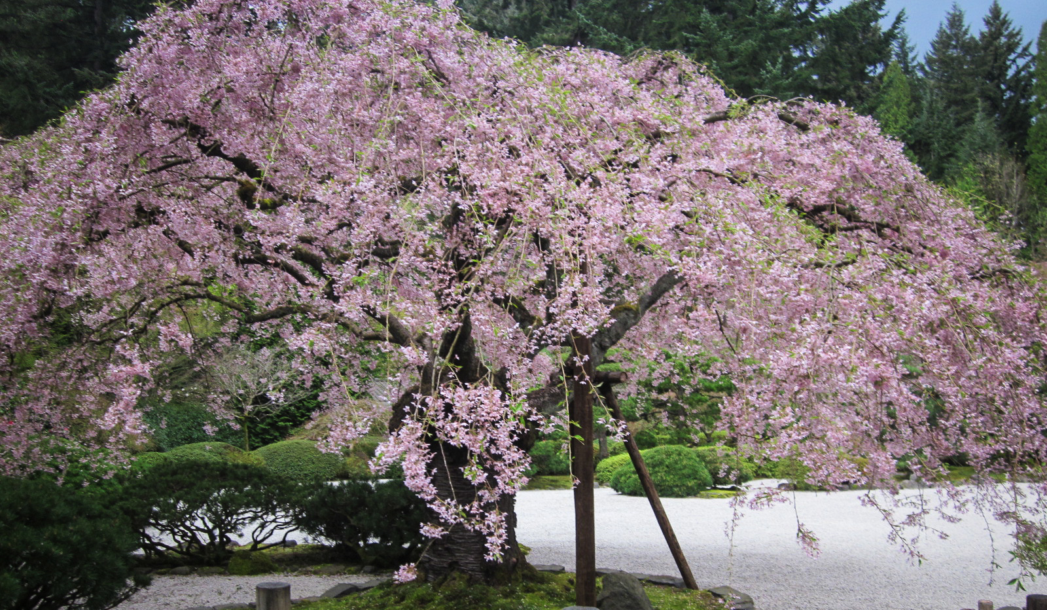
Living in harmony with nature: Japanese celebrate the return of blossoms on cherry trees
https://youtu.be/I2ArtWFNTqM

Slide 3
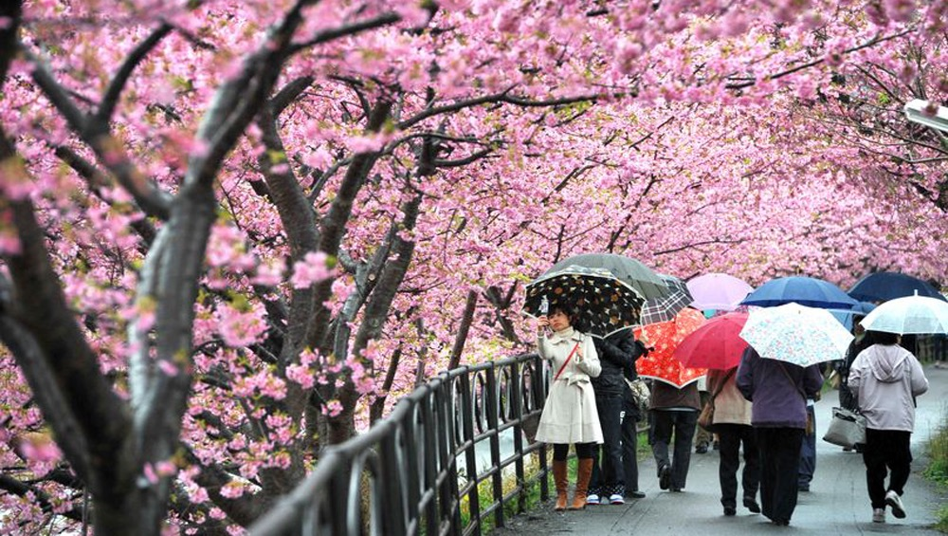
Cherry tree blossoms (in Japanese: sakura)
As spring arrives, Japan turns into shades of pink!

Slide 4
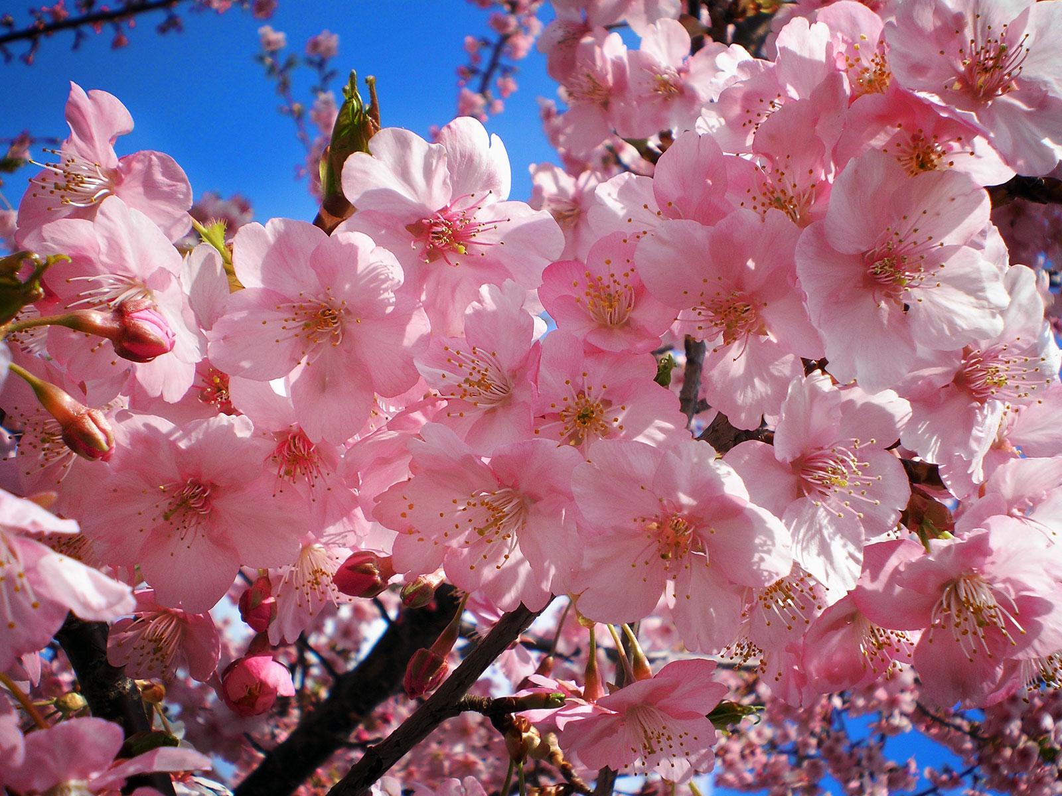
This beautiful and brave flower announces winter’s end

Slide 5
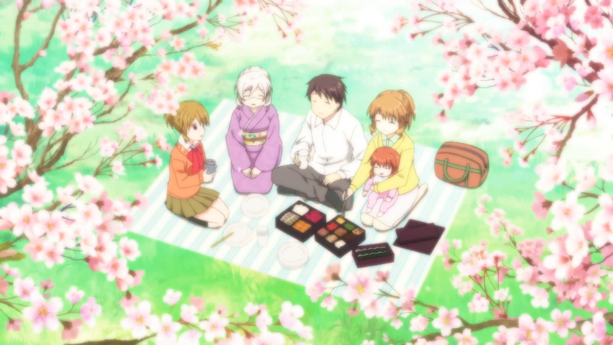
Hanami parties are special celebrations held under the blossoms of the flowering cherry trees

Slide 6
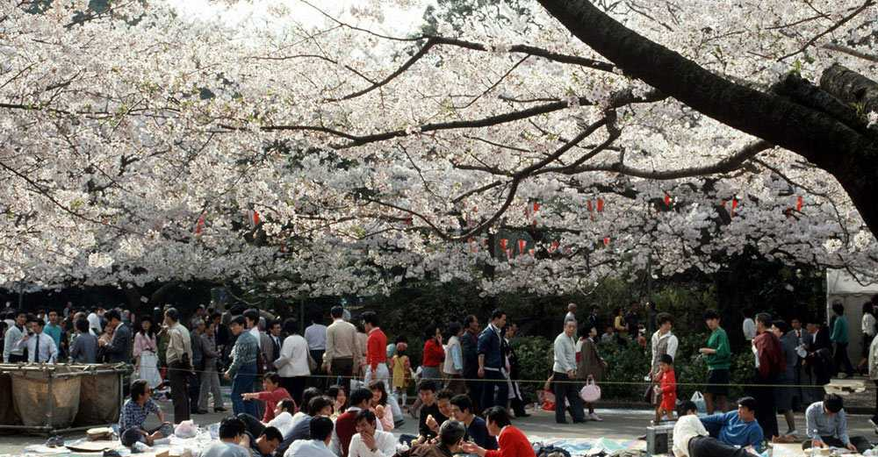
Hanami Haiku
in cherry blossom’s shade
there is no such thing
as a stranger
Kobayashi Issa
1763-1828

Slide 7
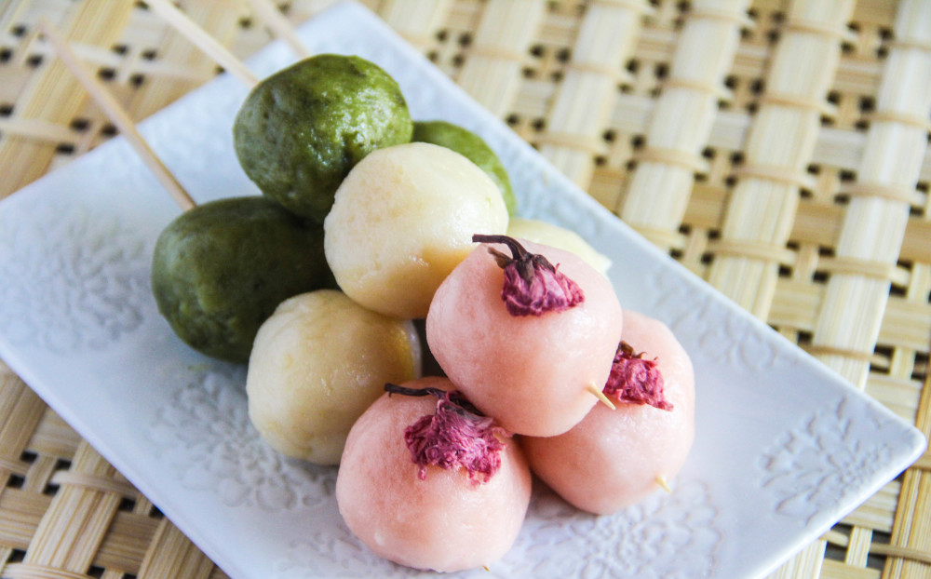
Special foods are made just for Hanami parties

Slide 8
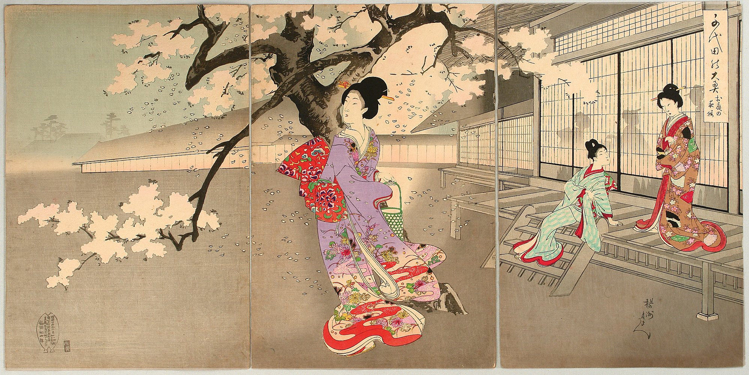
For more than 1,000 years, families and friends have gathered for Hanami parties for food and drink, games, music and poetry. Many artists have made beautiful pictures of the celebrations.

Slide 9
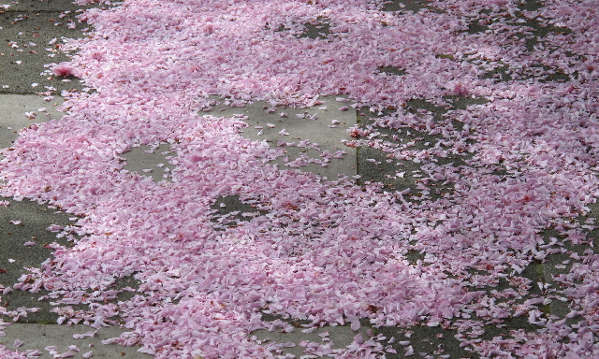
Sadly, sakura blossoms only last 2 weeks. Letting go is sad and beautiful. Nature is never finished, and they will be back next year!

Slide 10
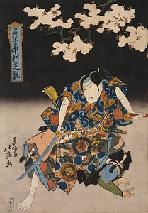
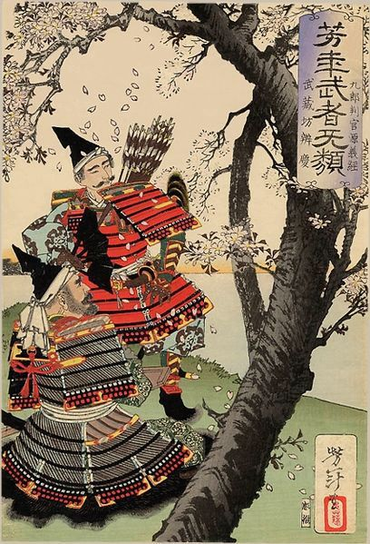
The blooming of cherry trees was important to samurai warriors: just like sakura, they were born to live brilliantly and die young

Slide 11
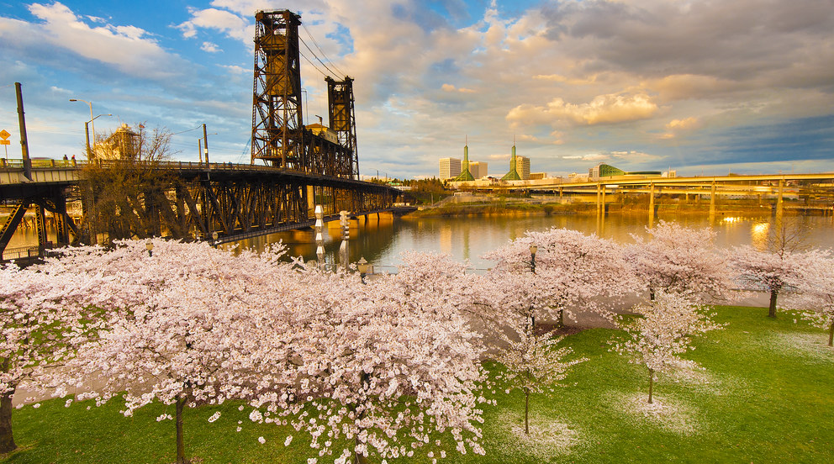
Sakura isn’t just celebrated in Japan!

Slide 12
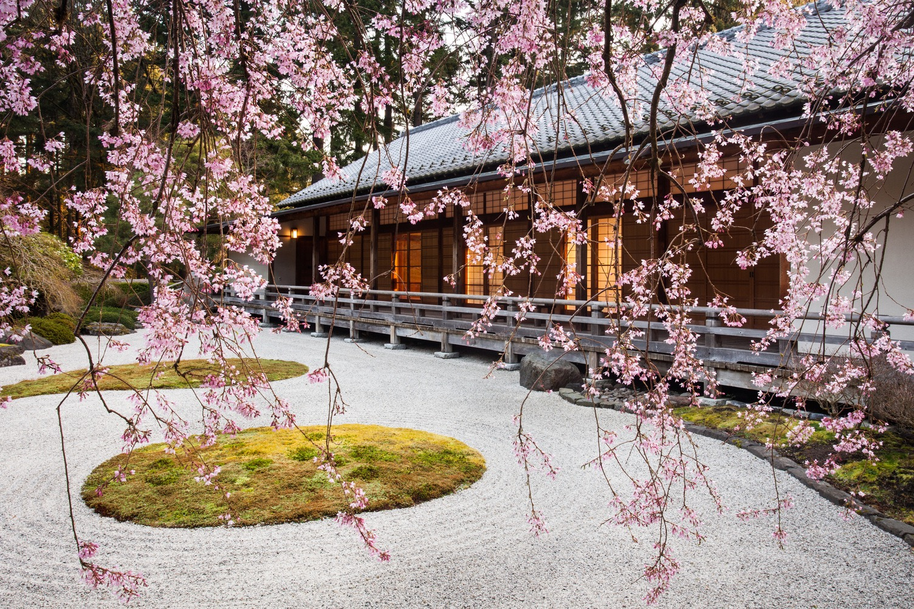
Every spring, visitors celebrate sakura blooming at Portland Japanese Garden!

Slide 13
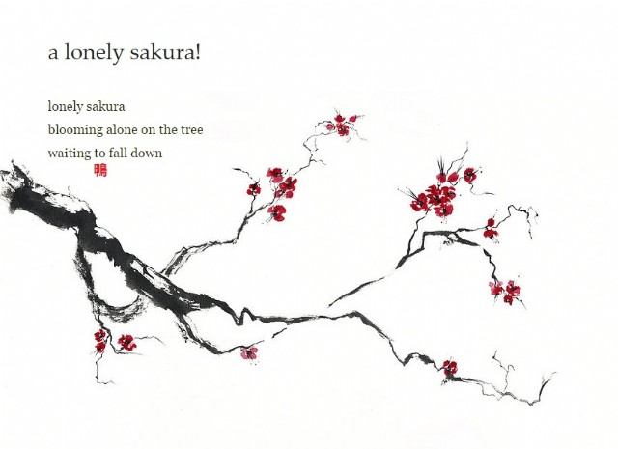
Sakura are gone in two weeks – but what if we can keep them alive…in a haiku poem?

Slide 14
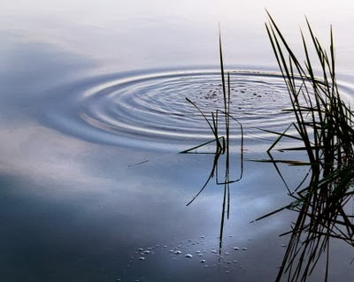
What is haiku -- remember?
Haiku is a form of Japanese nature poetry. It was first written over 400 years ago, and is now read and written all over the world
old pond
frog jumps in
sound of water
  ---Basho,
  Haiku Master (1644-1694)

Slide 15
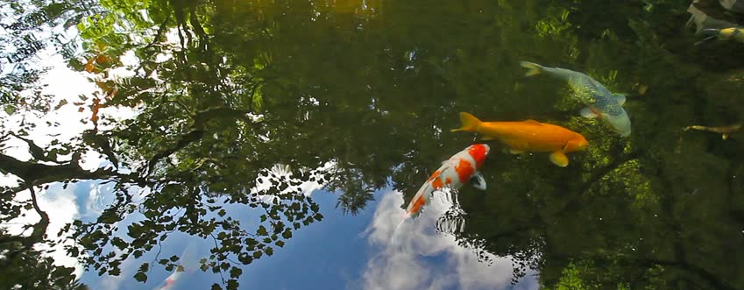
How do we write haiku?
A haiku is a three-line poem about nature with about 17 syllables and a sound pattern:
5 syllables in 1st line
7 syllables in the 2nd line
5 syllables in the 3rd line
orange koi racing
red and white flash blue water
ripples in sky chase

Slide 16
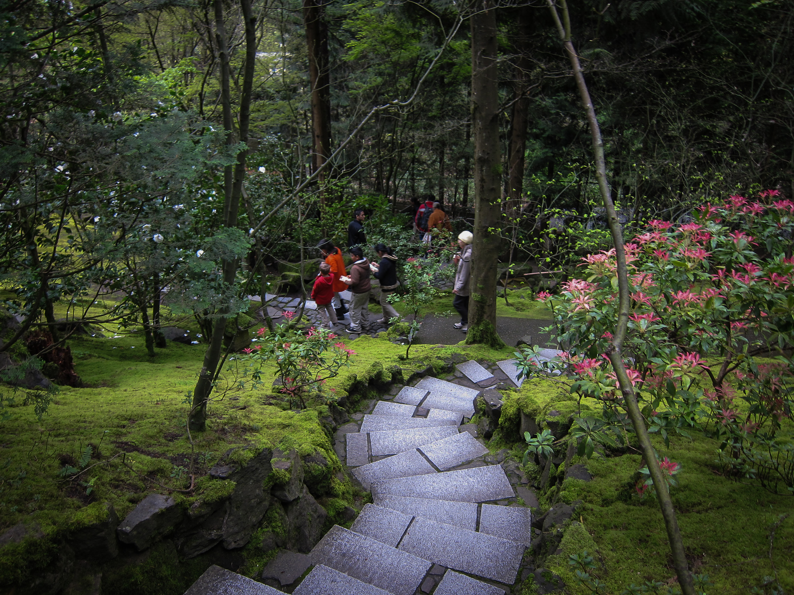
Inside a Japanese garden, every step is a new moment of discovery. In haiku, each of the three lines allows a fresh view of a simple moment.

Slide 17
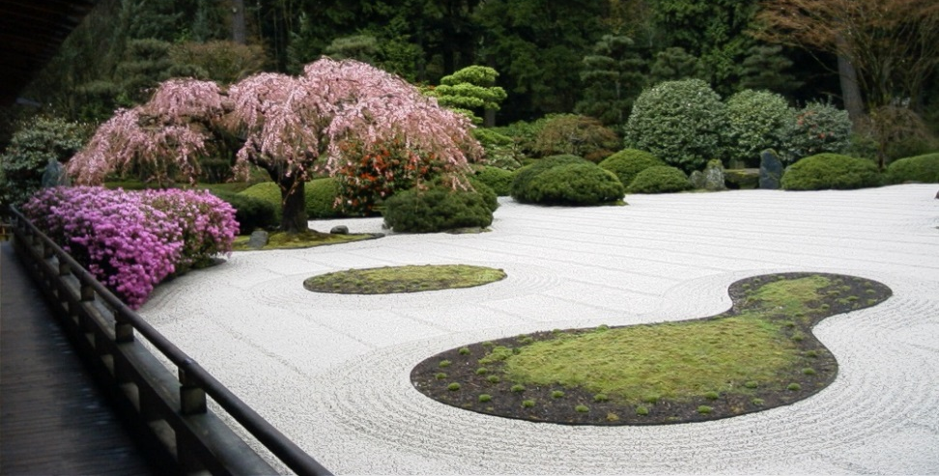
What are haiku poems about? These word pictures share the writer’s moment with the reader about:
Nature
Harmony and change over the four seasons
Discoveries of all five senses

Slide 18
Haiku are both simple and complicated!
3 lines
About 17 Sounds (5…7…5)
No punctuation needed
Reflections of nature
Present tense
Reflect the 5 senses
Word pictures
Only 3 Lines
Words count more than counting syllables
Show, don’t tell
Wonder about nature
Be in the moment
Stay curious
Picture your words

Slide 19
To begin writing, tune in to nature with your five senses
LOOK!
blossoms sway
tiny pink clouds
shy petals
LISTEN!
pink whispers
silence shaking
quiet vibrations
SMELL!
sweet fragrance
gentle wind
fresh buds
TASTE!
drops of rain
fresh earth
pink icing
FEEL/TOUCH!
hope springs
warm chill
harmony unfolds

Slide 20
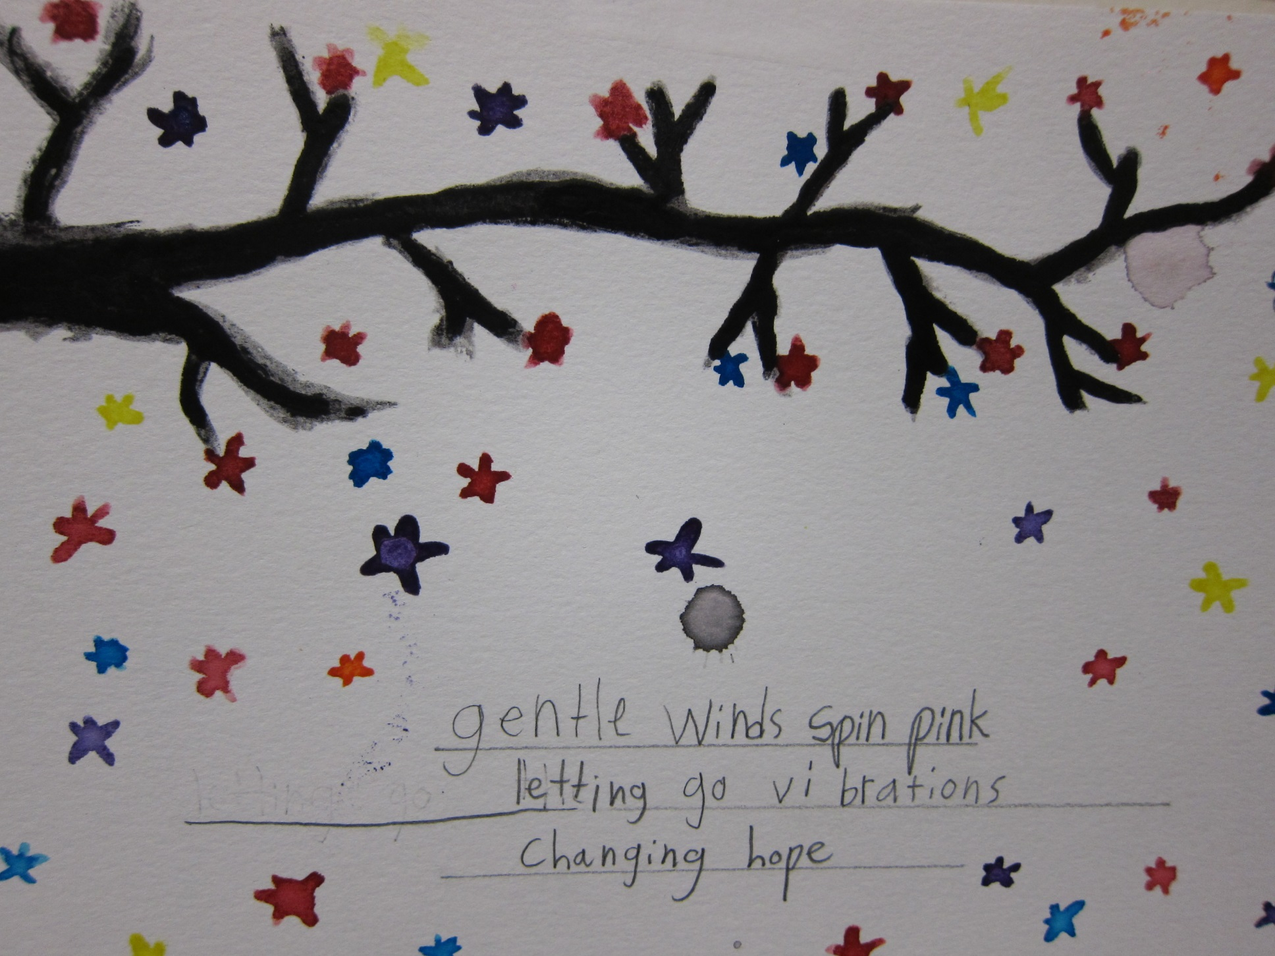
Haiku inspired by sakura!

Slide 21
Now it’s your turn to practice sakura haiku!
trees growing pink
red blooming bright moss climbing
rain drops hit leaves
Jeremiah—4th grade

